Slide 1








9.4T MRI scanner: update on the development at NKI
Alexandre Franco
June 23, 2025
Notes:
Project has been going on for 7 years now.
Some of you have heard about this project, and some have not.
Goal is to give members of NKI some updates.
Please feel free to interrupt me. If we go over time, we can continue this conversation next week, since it looks like there is nothing scheduled for next Monday.

Slide 2

Why Ultra High Field MRI?
( $≥$ 7T )

Slide 3
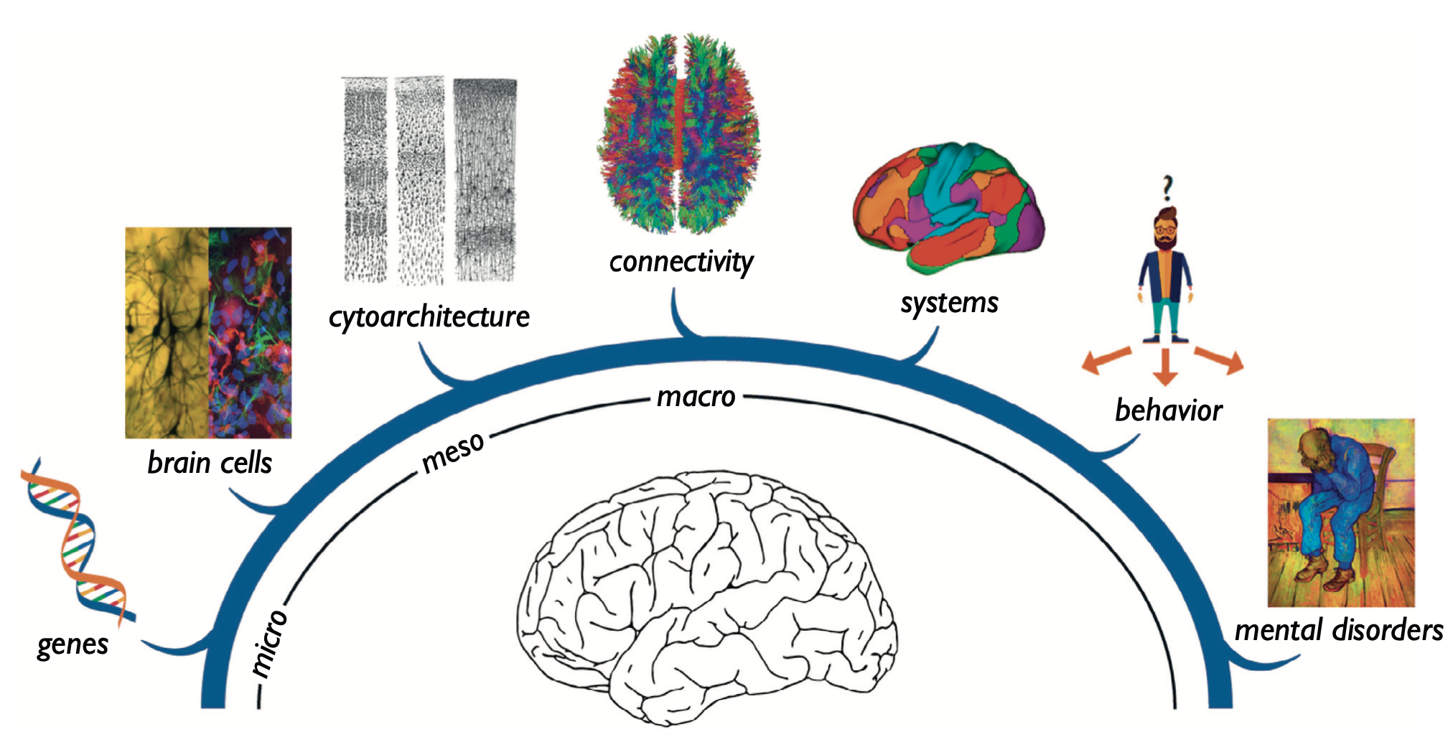
Why Ultra High Field MRI?
Adapted from van den Heuvel, Scholtens, and Kahn, 2019
Notes:
bridges the gap between basic research and clinical applications
Connect research from brain cells to whole brain connectomics

Slide 4
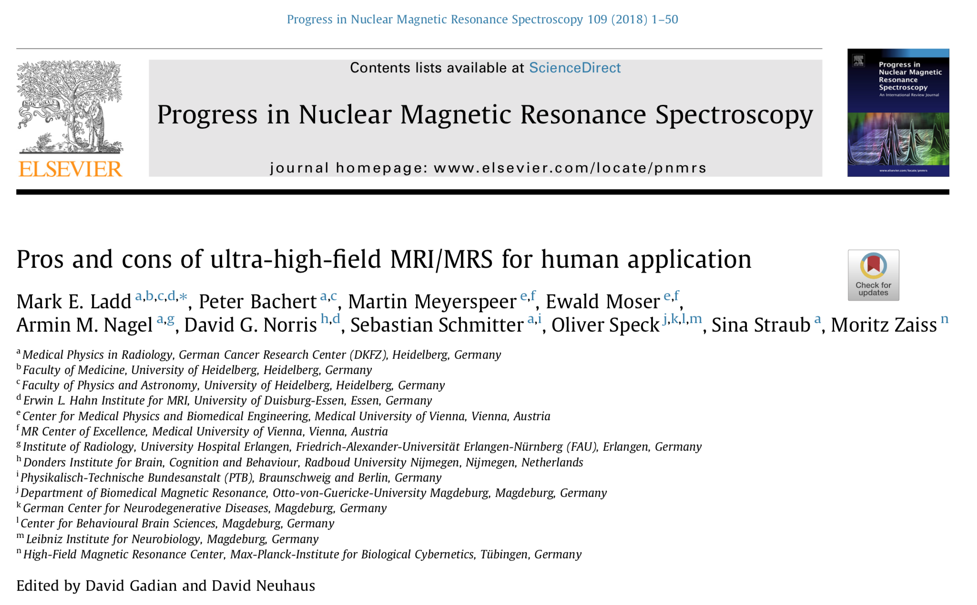
Why Ultra High Field MRI?
Advantages
Gains in signal-to-noise and contrast-to-noise ratio that allow finer structures to be visualized
Smaller physiological effects to be detected.
Greater Spectral resolution
Challenges
Non-uniform radiofrequency fields
Enhanced susceptibility artifacts
Higher radiofrequency energy deposition in the tissue.
Notes:
Basically just a much better microscope
Costs
Higher sensitivity also has its drawbacks.

Slide 5
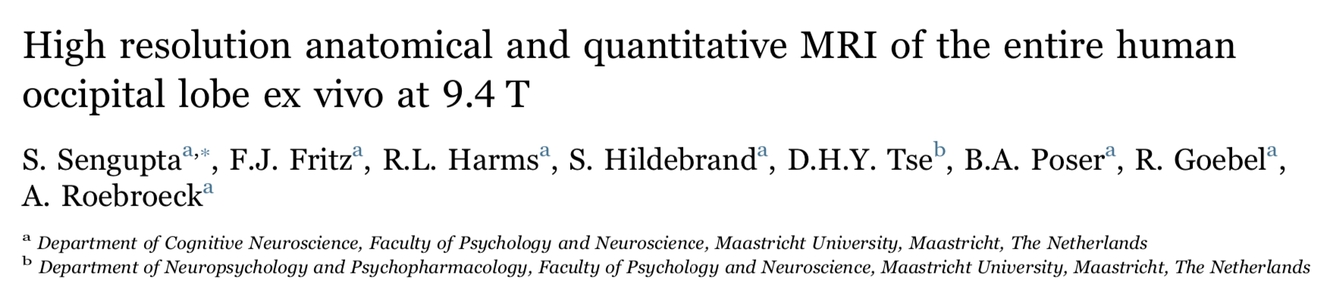
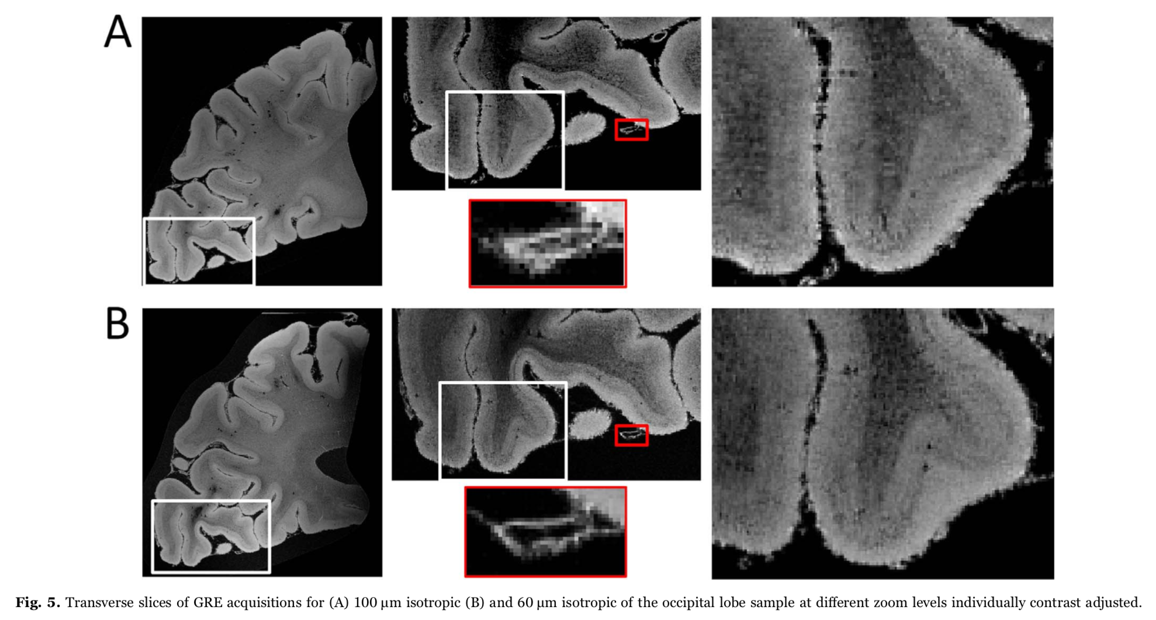
Why Ultra High Field MRI?
100 μm isotropic
60 μm isotropic
Notes:
At the Netherlands

Slide 6
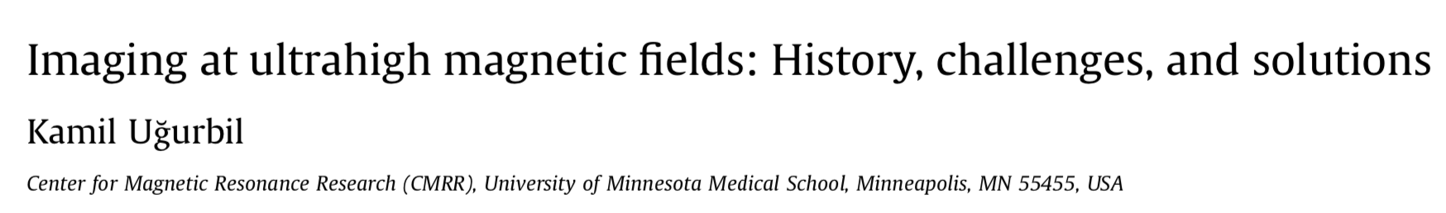
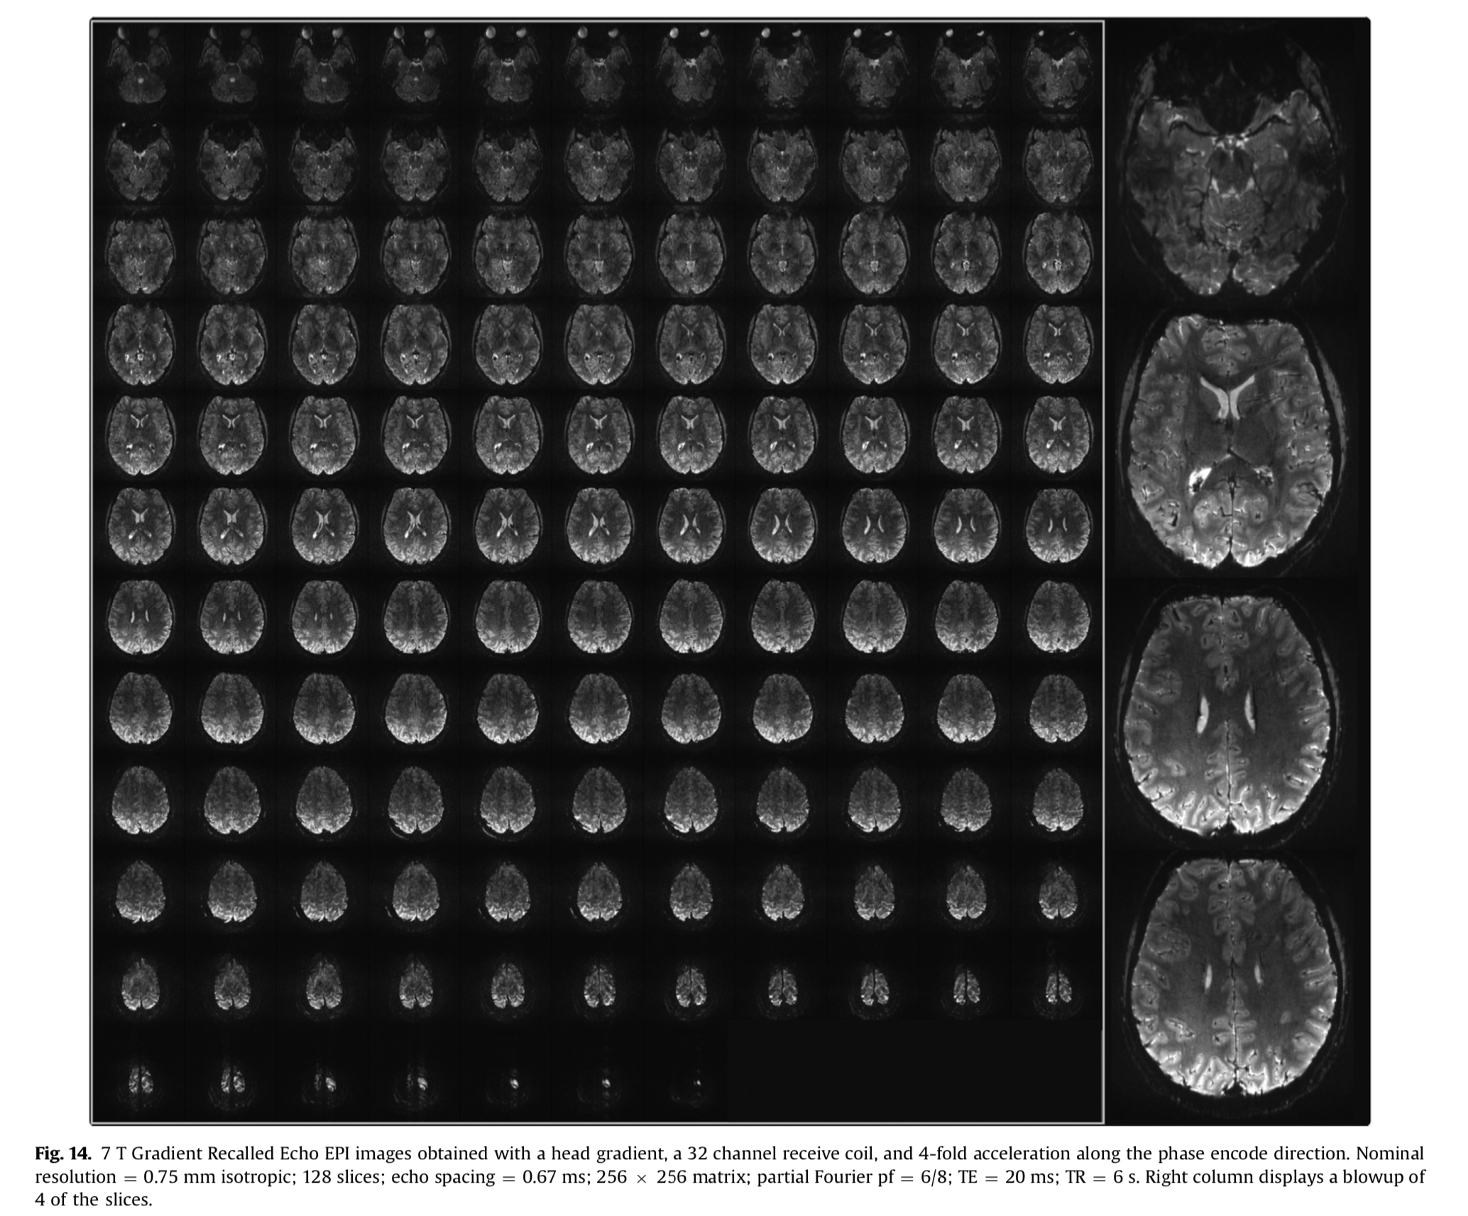
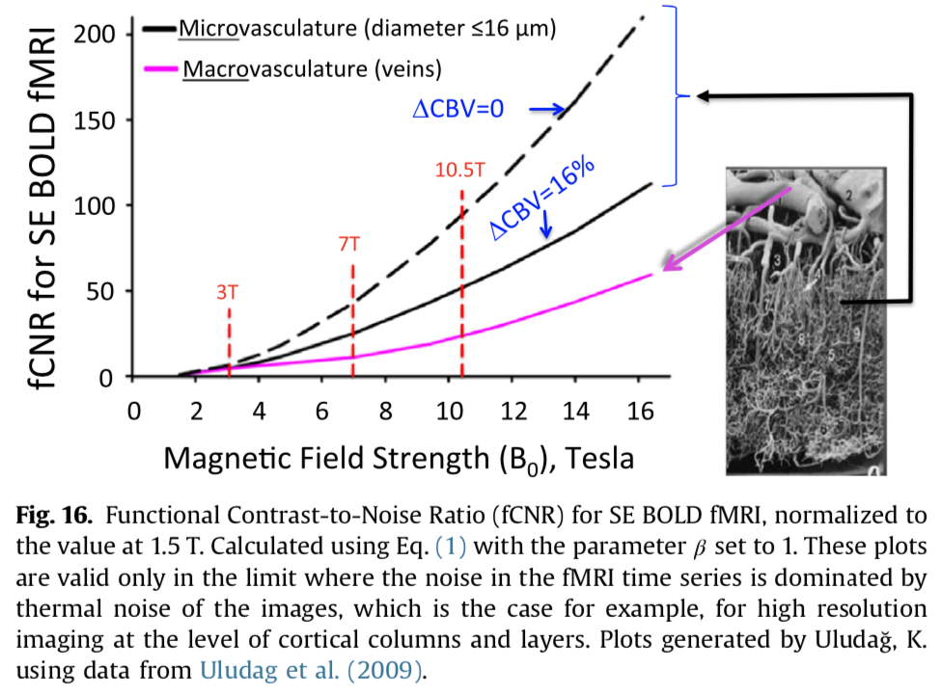
Why Ultra High Field MRI?
Notes:
Improved specificity of BOLD signal: At higher fields, the BOLD signal becomes more localized to the microvasculature directly surrounding active neurons, rather than larger draining veins, thus providing a more accurate reflection of neuronal activity.

Slide 7
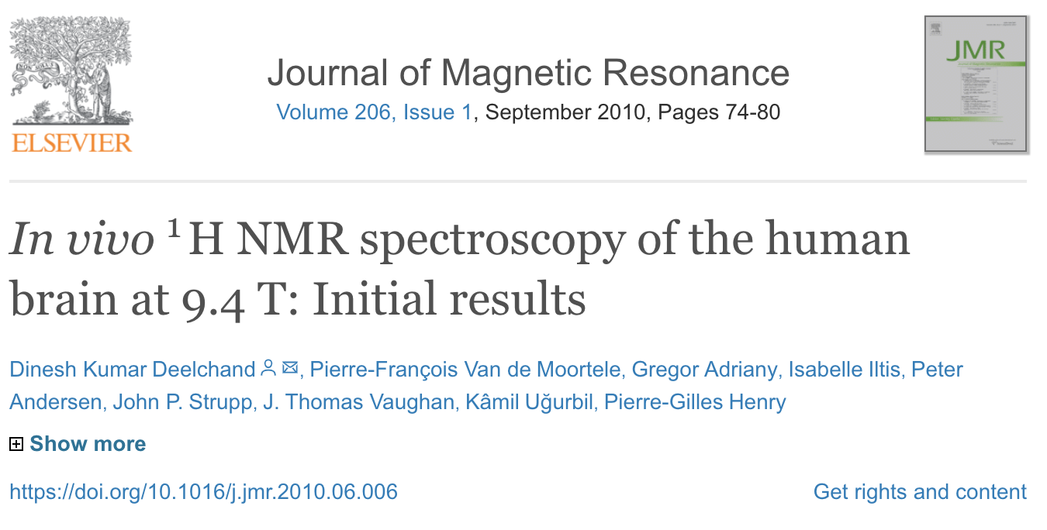
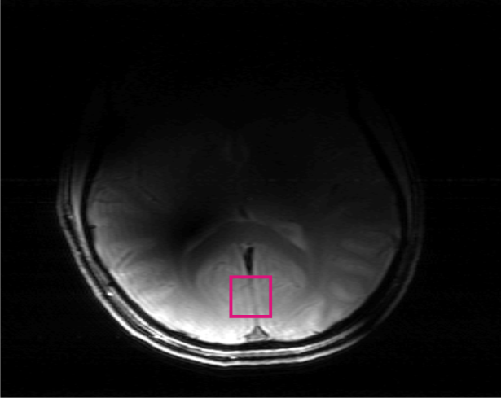
Why Ultra High Field MRI?
Visual cortex
Notes:
Higher Spectral Dispersion: Stronger magnetic fields spread out the resonance frequencies of different metabolites, improving the resolution and quantification of specific neurochemicals in MRS. This provides insights into the biochemical basis of neurological diseases.
Glutamate and glutamine, which are not resolved from each other at 1.5 T, are resolved progressively better with B0 increasing from 4T53, to 7 T 51, and to 9.4 T 5
Imaging of Non-Proton Nuclei: UHF MRI facilitates the imaging of nuclei other than hydrogen (protons), such as sodium, which can provide unique information about cellular metabolism and tissue health not accessible with standard proton MRI
Glutamine fuels brain cells
Glutamate is a crucial amino acid that serves as the primary excitatory neurotransmitter in the brain

Slide 8
Current Ultra High Field Magnets
>7T

Slide 9
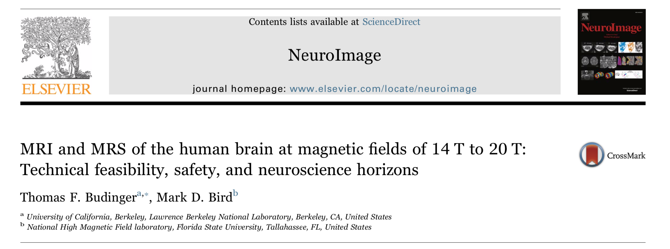
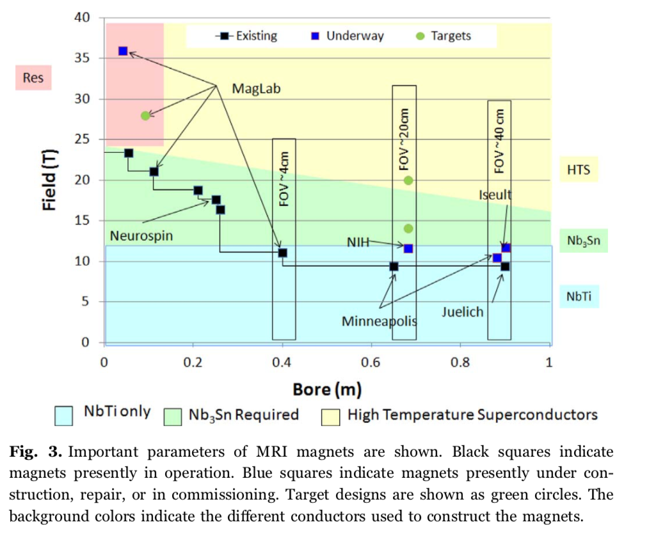
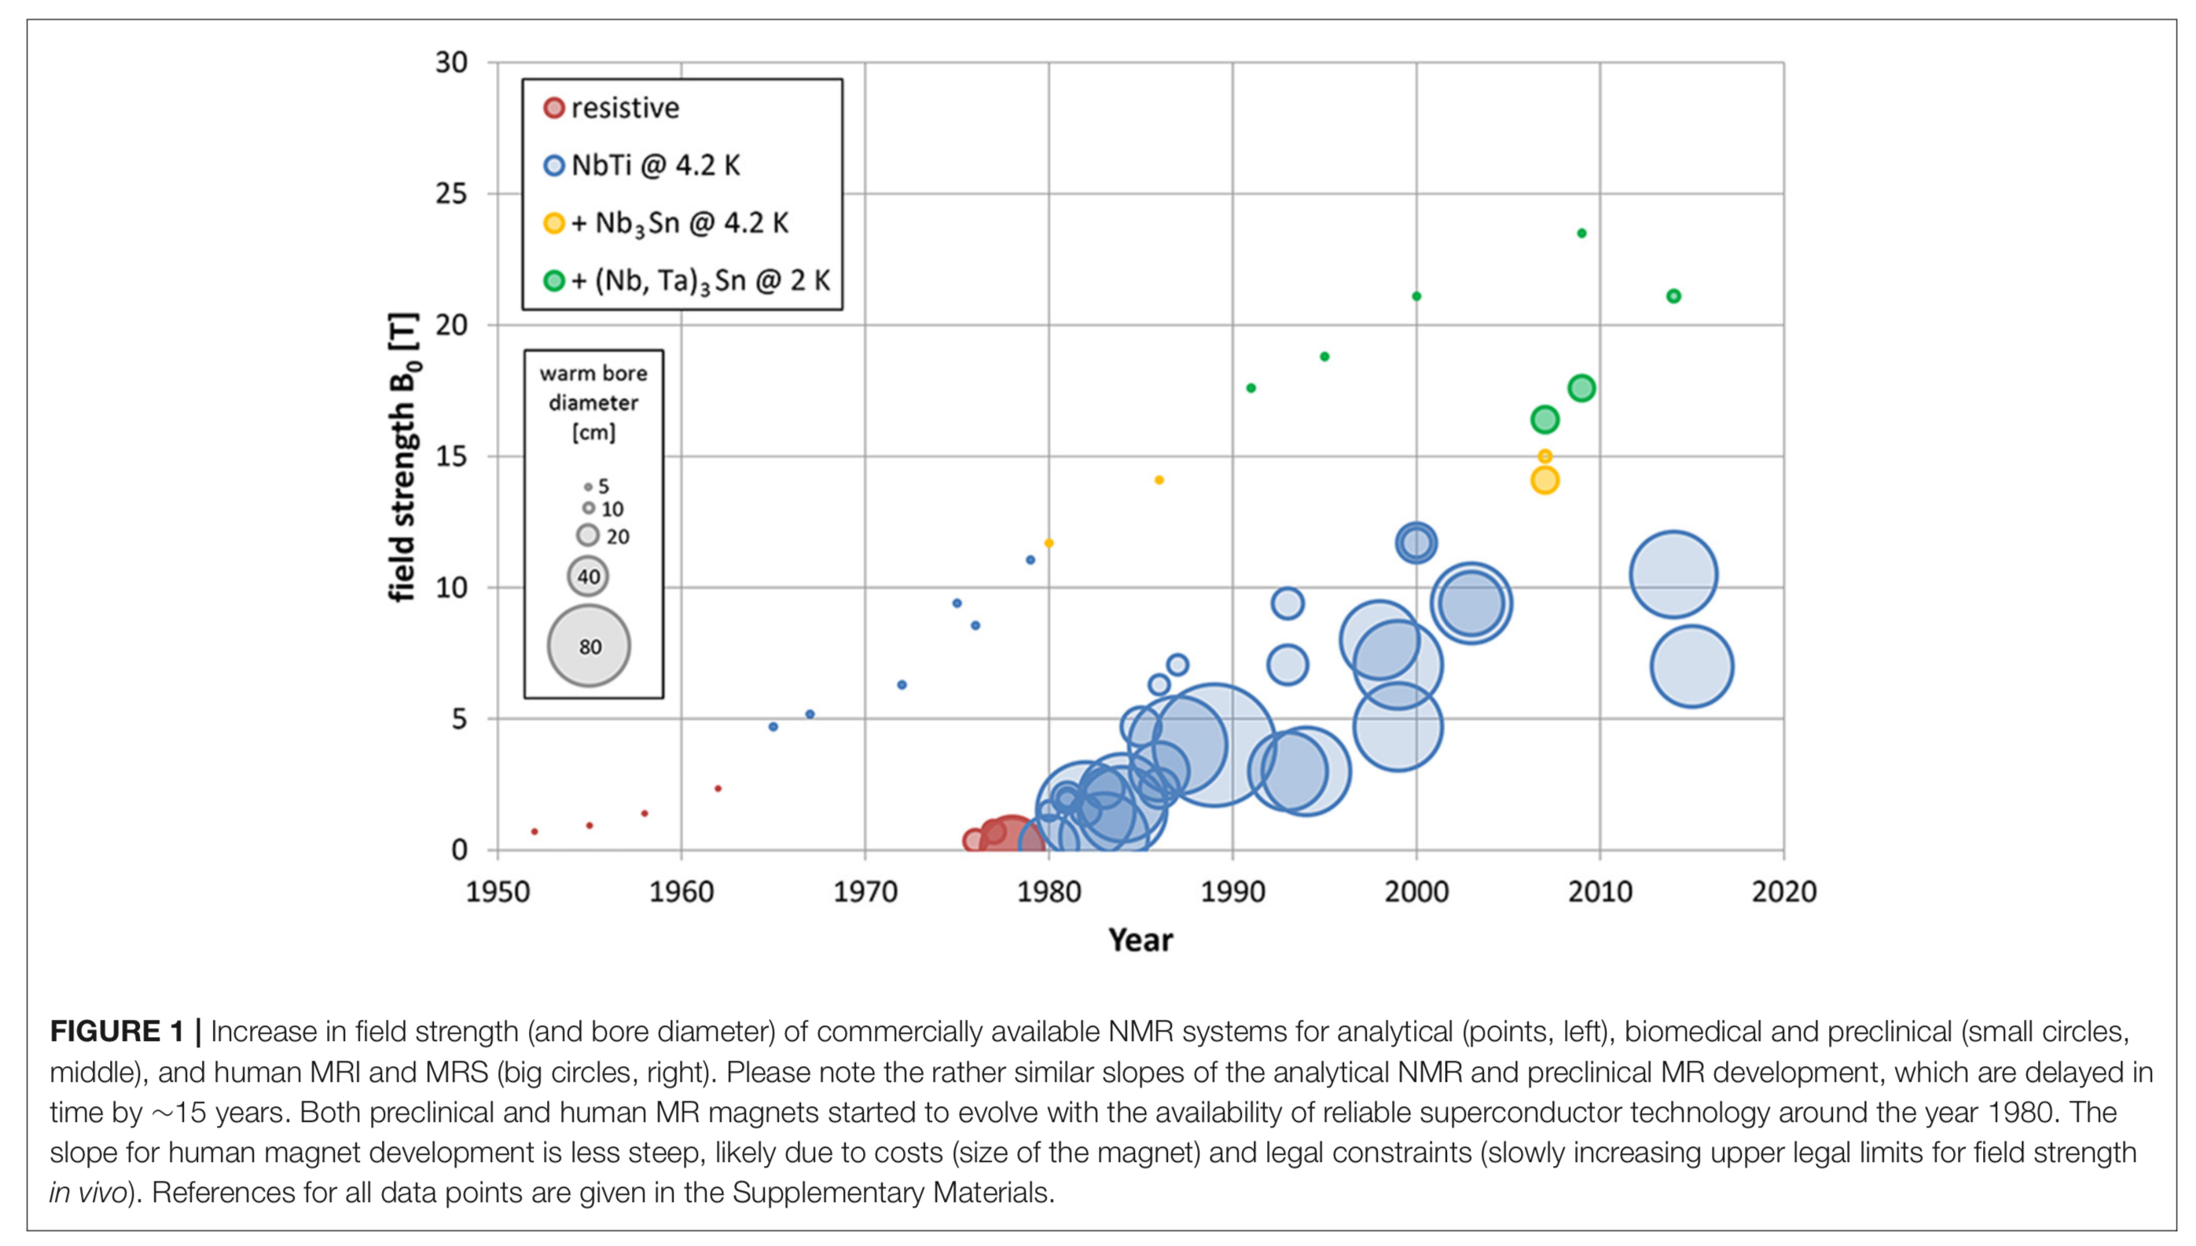
Current Ultra High Field Magnets
Notes:
here are 83 7 T MRIs, four large bore 9.4 T MRIs (), one 10.5 T whole body MRI, and two 11.7 T functioning, and another 11.7T that is currently off..
NBTI - Niobium–titanium
NB3SN - Niobium–tin
Germany and China going to a 14T Magnet

Slide 10
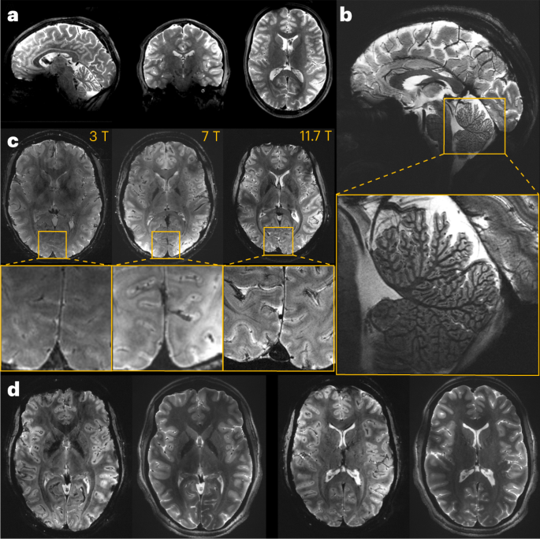
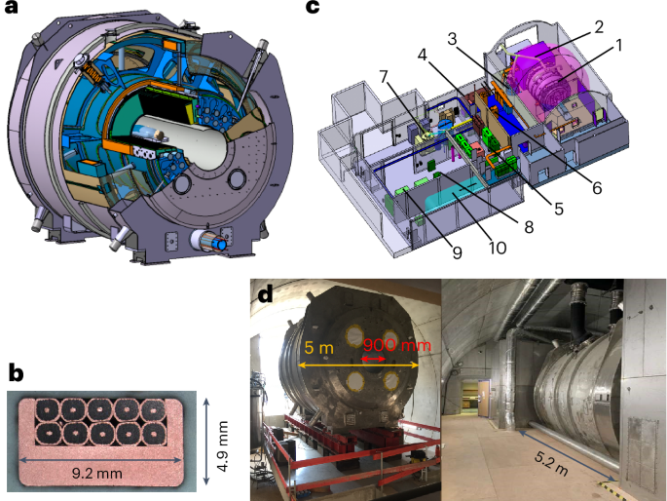
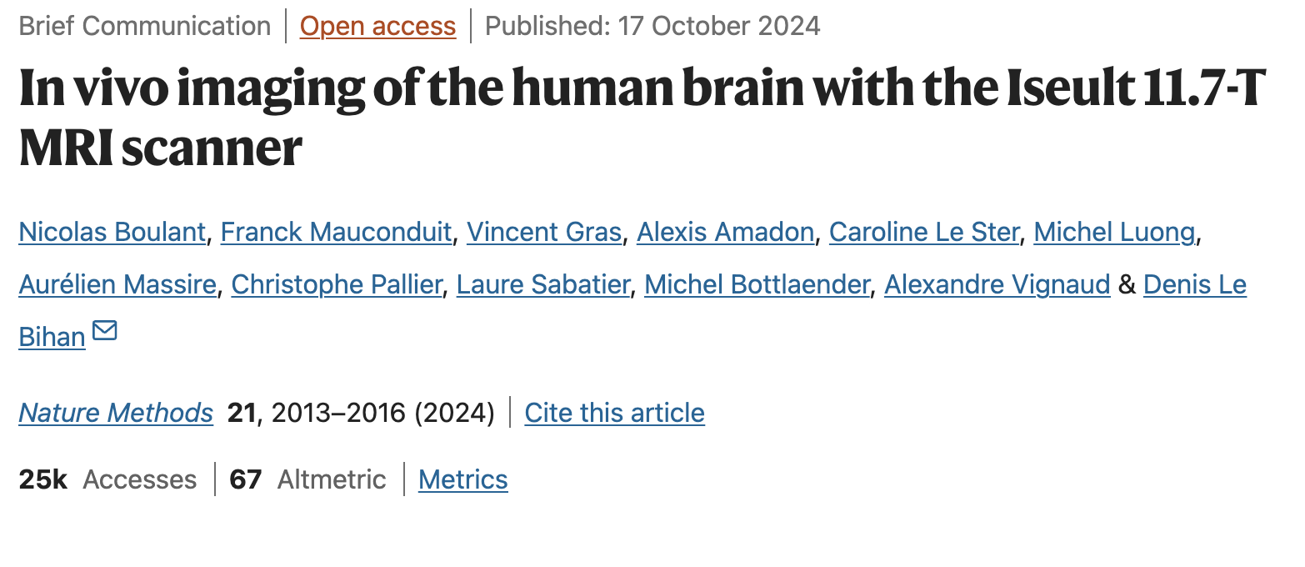
Current Ultra High Field Magnets
11.7T Iseult/Inumac - France
Maximum gradient strength and slew rate of 70 mT/m and 200 T/m/s
Notes:
INUMAC stands for "Imaging of Neuro disease Using high-field MR And Contrastophores,
Location:
Neurospin, a neuroscience research center at CEA Saclay, France. $270M project

Slide 11
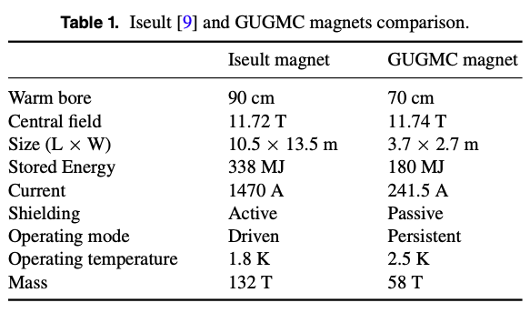
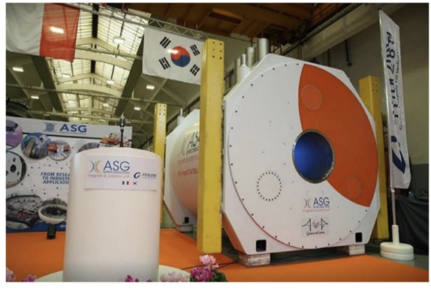
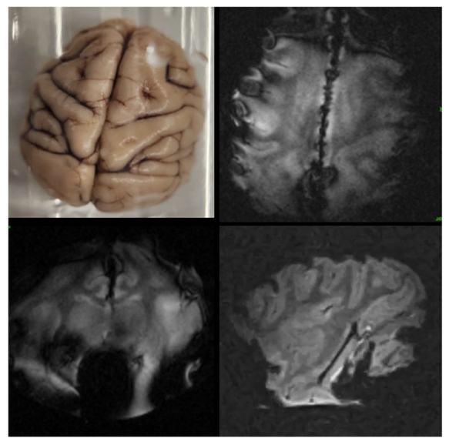
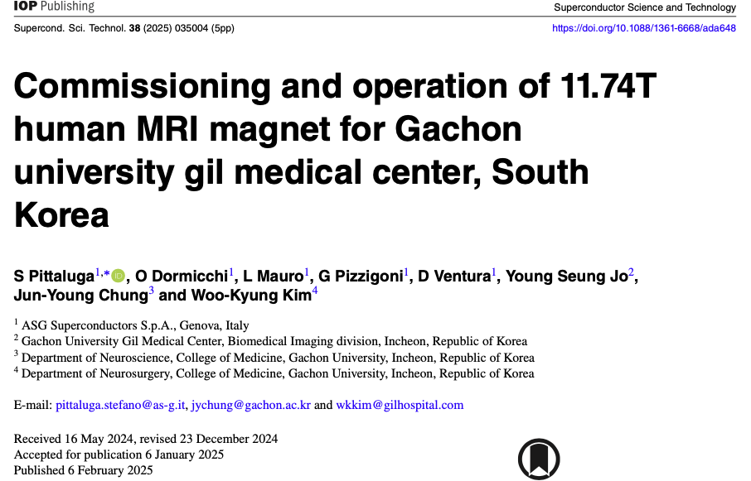
Gachon Medical University 11.7T
Incheon, South Korea

Slide 12
Current Ultra High Field Magnets
10.5T, Minnesota
Whole Body
11.7T, NIH
Head only

Slide 13
Ultra High Field Magnets
9.4T/900mm
Tübingen, Germany
9.4T MRIs
9.4T/Whole Body
University of Chicago
Decommissioned
9.4T/820mm
FZ Jülich, Germany
9.4T/whole body
Maastricht University
Notes:
Ralph Polhamann

Slide 14
9.4T MRI Being Developed at NKI

Slide 15
Expected Capabilities
In-plane spatial resolution for brain structural imaging of less than 50 microns
Whole-brain functional imaging with a temporal resolution of 100ms and submillimeter voxel size
High resolution spectroscopic measurement of metabolites and neurotransmitters in human brain will be comparable to values heretofore achievable only in small rodent models. Receiver channels (64 x ¹H, 32 x X nuclei). Possible range of experiments on virtually any nucleus (¹H, ¹³C, ¹⁷ O, ¹⁹F, ²³Na, ³¹P, ³⁹K,…)
Trans-species imaging
Notes:
X-nuclei imaging, on the other hand, aims to reveal the underlying changes in the physiological processes on a cellular level.

Slide 16
2018
May: Submitted S10 proposal to NIH for funds for the 9.4T (Total requested $2M)
2019
January: Submitted Major Research Instrumentation (MRI) proposal to NSF for developing 9.4T MRI (Requesting limit of funding mechanism: $4M)
September: Resubmitted MRI proposal to NSF since previous proposal had not been reviewed - error from NSF program officer (Total requested: $4M)
2020
November: Kickoff meeting with OGS, OMH, NKI, and Architecture consultants to start designing site for 9.4T
December: Bill of sale signed to purchase the 9.4T Magnet from the University of Minnesota (Total cost: $700k, $350k from RFMH and $350k from Columbia University).
2021
January: Arrival of 9.4T Magnet in warehouse in Kerny, NJ January: Resubmitted MRI proposal to NSF (Total requested $3.94M)
September: NSF project started to develop 9.4T MRI (Total funded: $3.74M)
2022
November: Submitted proposal to Keck foundation for equipment for 9.4T lab (Total requested $1.2M)
2023
January: Submitted MRI proposal - Track 3 to NSF for cryogen reliquification system (Total requested: $407k)
April: Resubmitted proposal to Keck foundation for equipment for 9.4T lab (Total requested $1.2M)
2024
July: Arrival of Radio Frequency (RF) amplifiers from Communications Power Corporation (CPC) (Cost: $436k)
February: National Institute of Health (NIH) grant proposal (R01) submitted for integrated dynamic multi-shim coils and RF coils. We received a 26% score. (Requested: $3.4 M)
November: Resubmitted integrated dynamic multi-shim coils and RF coils after addressing reviewer comments. NIH withdrew it as a Columbia University partner left the country. (Requested: $3.4 M)
2025
May: Submission to Keck requesting funds for AI Radio Frequency Coil (Total requested: $1.3M)
June: Delivery of final site construction documents for Bidding.
July: Expected to resubmit integrated dynamic multi-shim coils and RF coils grant proposal to NIH. (Requested: $3.4 M)
November: Expected to resubmit MRI proposal - Track 3 to NSF for cryogen reliquification system (Total requested: $407k)
2026
August: End date of 5 year of MRI development project from NSF
2027
August: End date of one year no-costs extension for NSF grant
…

Slide 17
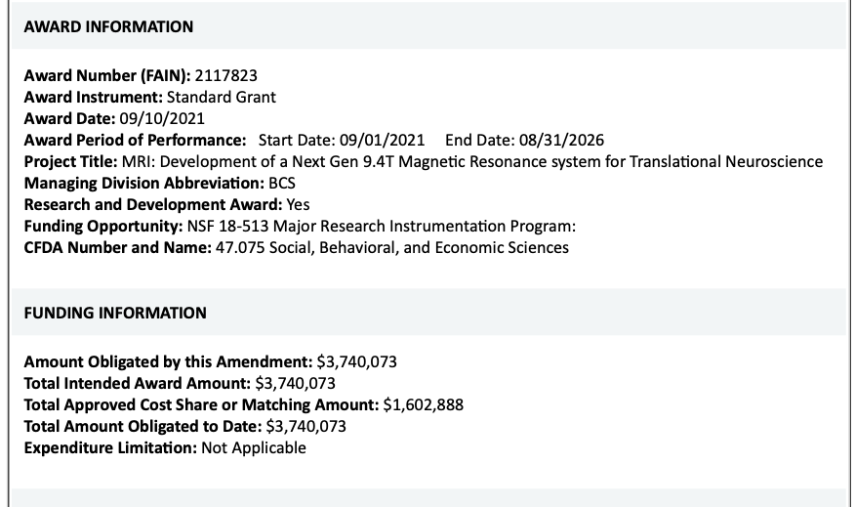
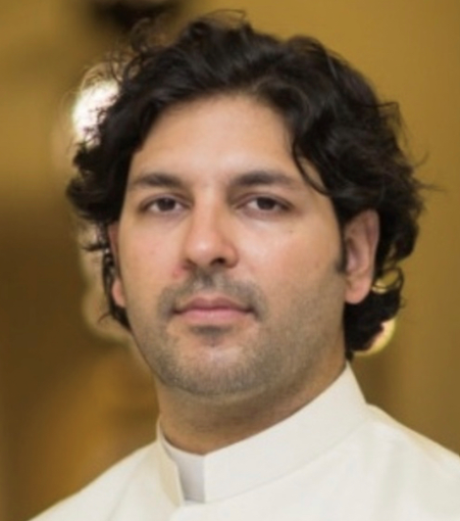
Hands-on Leader / Research Scientist
PIs:
Tommy Vaughan, NKI and Columbia
Alex Franco, NKI
Mike Milham, NKI
Thomas Foo, GE Healthcare
Dan Sodickson, NYU Langone
Wasif Zia, NKI

Slide 18
Overview of Development
GE
Gradients
MGI
Mounts
HG4#2
fab.
Auxiliary Components
Console
System Integration
NDA
NDA
NKI
Tesla
Shielding simulations
Passive
shim design
shop drawings
Shim tube fab.
Magnet ramp-up
Shimming/ calibrations
First images
OGS
Site planning
and design
Checks and final submission
Bids / Award
Construction
Development of RF Coils
Development of Data Management Network
Communications Power Corp.
RF and Safety Lab

Slide 19
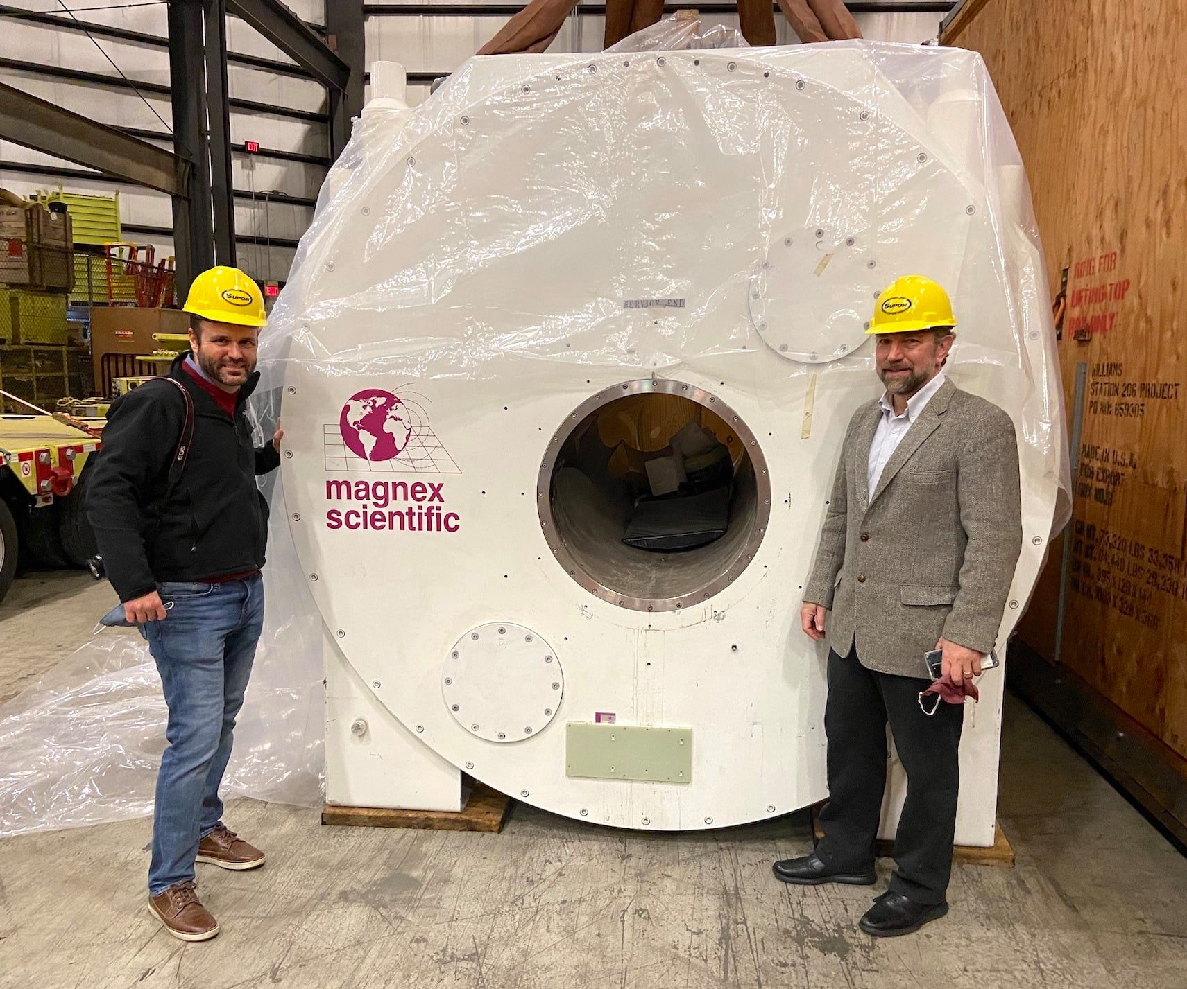
9.4T Head Only + NHP Imaging
9.4T, unshielded
Stored energy 78MJ
Conductor: 354 km
Weight: 27,215 kg (30 Tons)
Length of cryostat: 3.14m
Height: 3.48m
Warm bore: 65cm
Fitted with 2 cold heads
5G = 20.4m axial x16.9m
Supercon and passive shims
(shims on the gradient)
Magnex Scientific Magnet
Installed in April of 2004
Arrived in NJ in Jan 2021
Center For Magnetic Resonance Research, University of Minnesota, Minneapolis, MN
Notes:
Tesla Certified that it is functioning. Change the coldheads.
Bed and other things are currently in building 19?
Imaging volume 30cm dsv
DVS (Diameter Spherical Volume)

Slide 21
MR Gradients
Gradient Coils
Shift in resonance frequency throughout the scanner
Notes:
Gradient Strength
Slew Rate

Slide 22
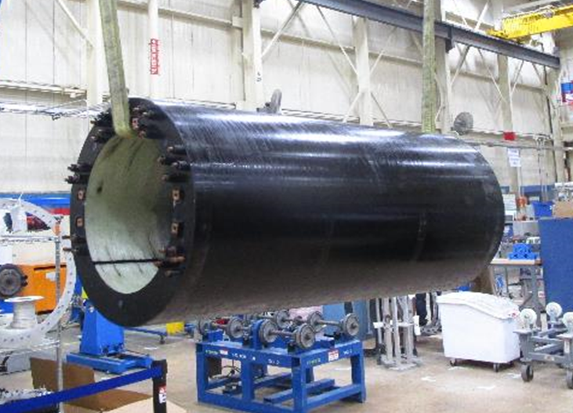
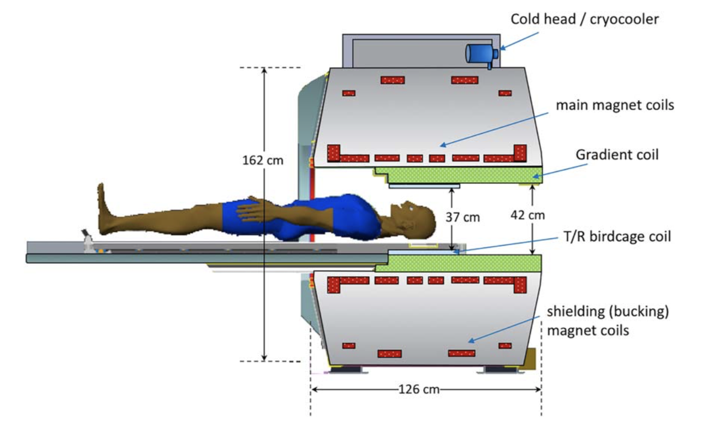
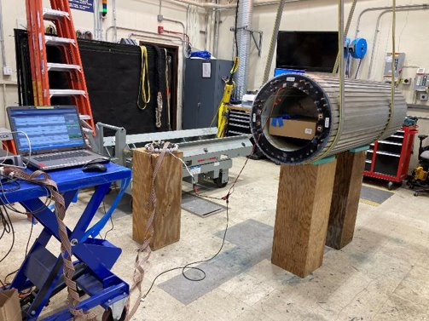
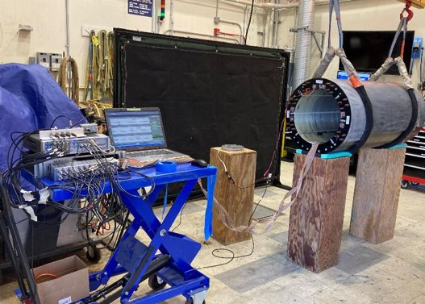
Head Gradient 4 (HG4)
Gradient Strength:
150 mT/m
Slew rate:
850 T/m/s
Notes:
Can cause peripheral nerve stimulation
Siemens Prisma 3T
Peak strength: 80 mT/m
Slew Rate: 200 T/m/s
NKI’s Siemens 3T Trio (Whole body):
Peak strength: 45 mT/m
Slew Rate: 200 T/m/s
Build in Florance South Carolina

Slide 23
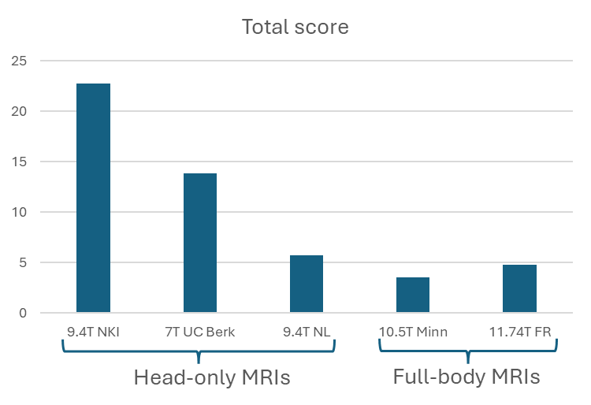
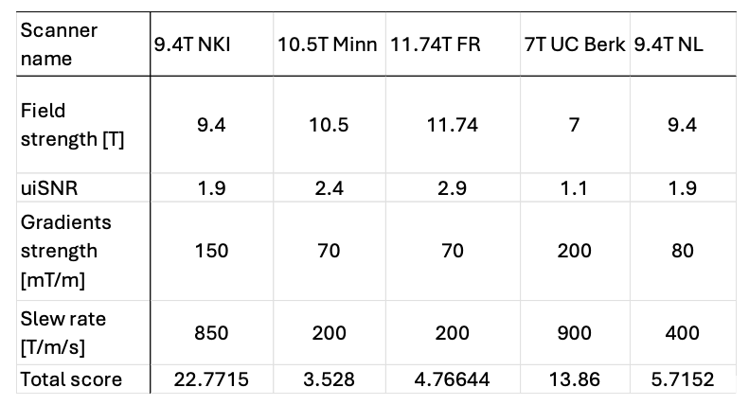
How does the proposed NKI 9.4T compare to other MRIs?

Slide 24
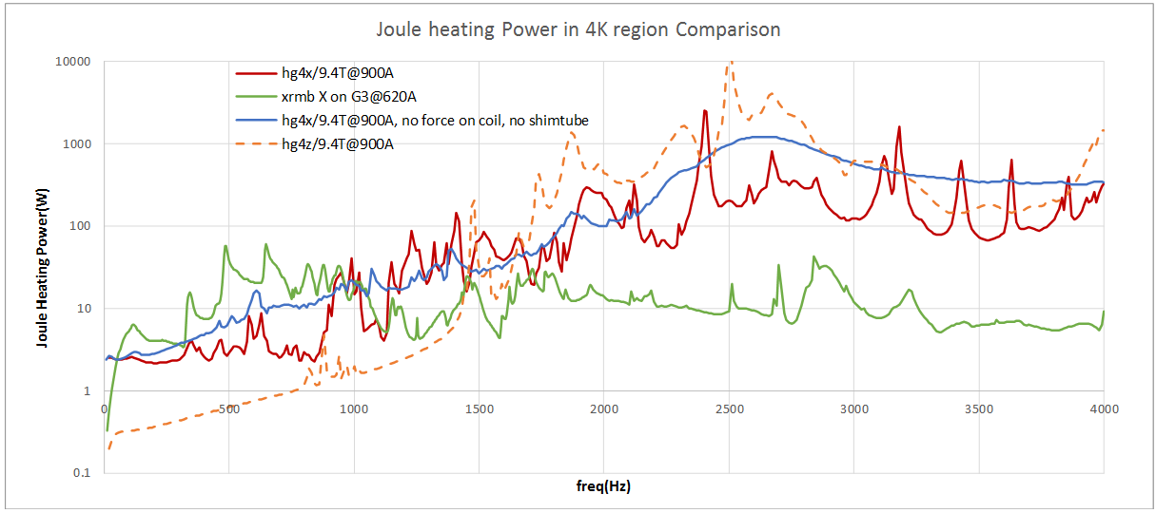
MGI
MGI heating in 9.4T magnet (red) is expected to be smaller or comparable to a whole-body 3T scanner (green) below ~1500 Hz where most gradient energy is.
Notes:
Magnet Gradient Interaction

Slide 25
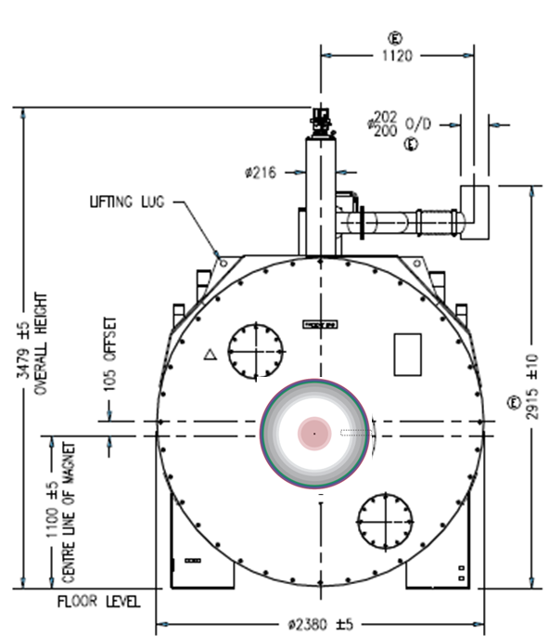
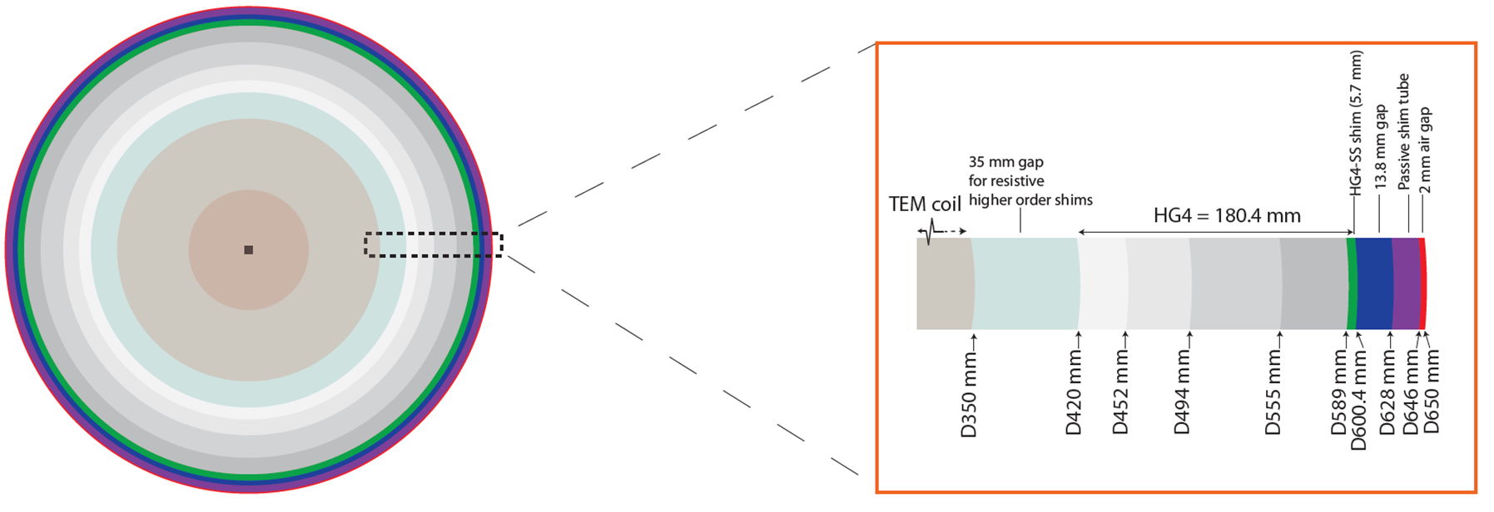
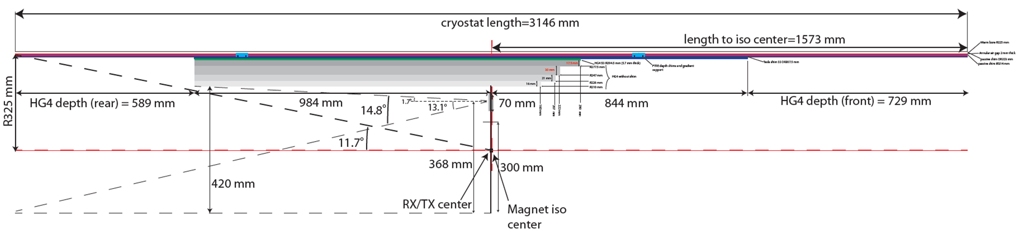
Shim tube
400% Zoom

Slide 26
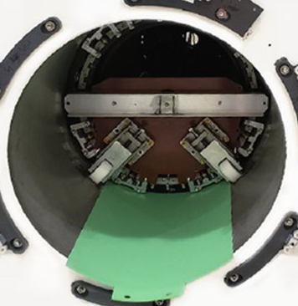
Mounting
There are four aspects to mounting:
1. Gradient insertion tool
2. Front mounts after loading into magnet (Patient end)
3. Rear mounts (service end)
4. Padding
Notes:
Cooling

Slide 27
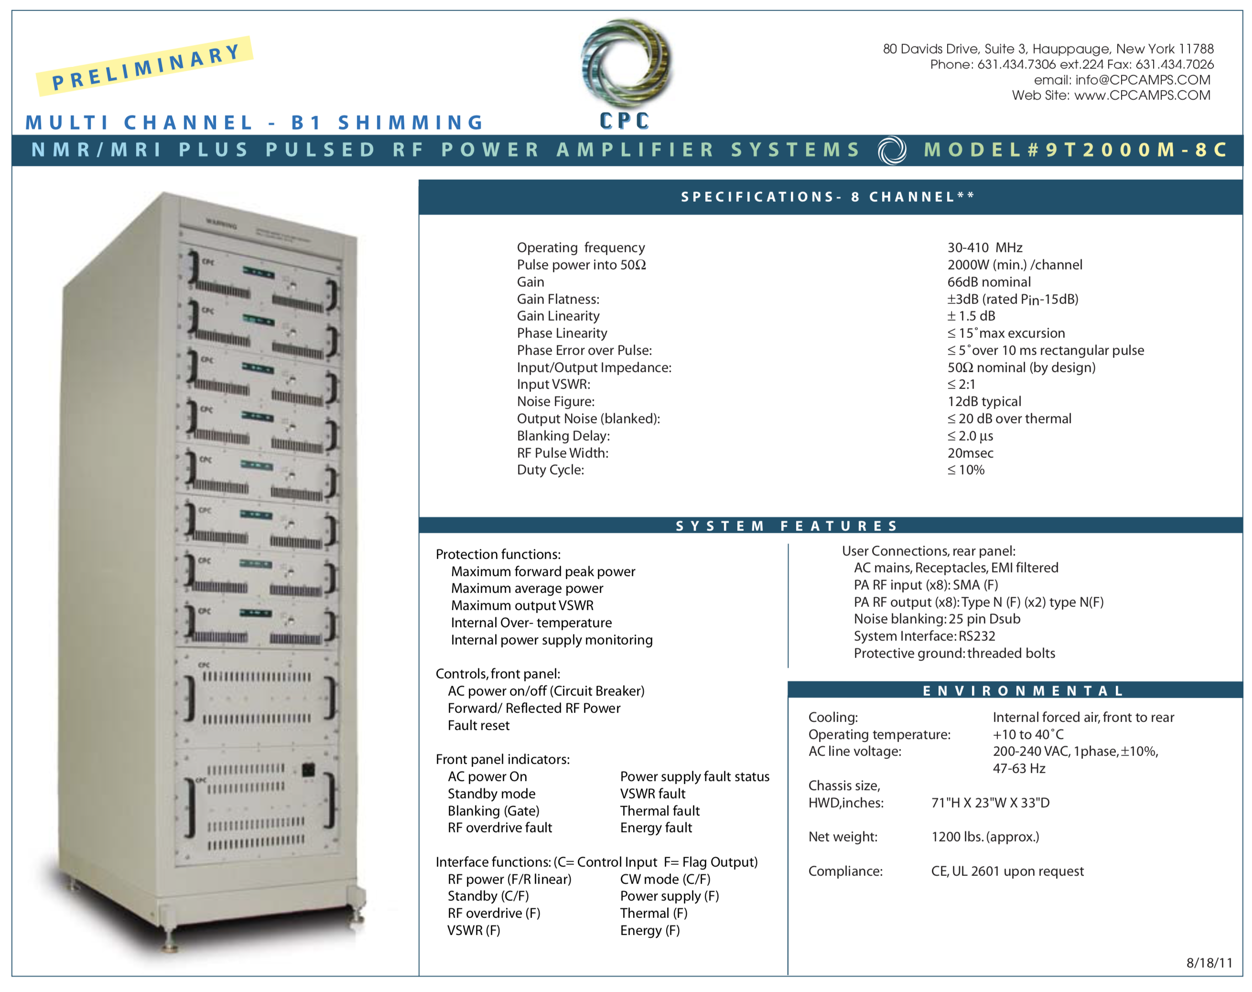
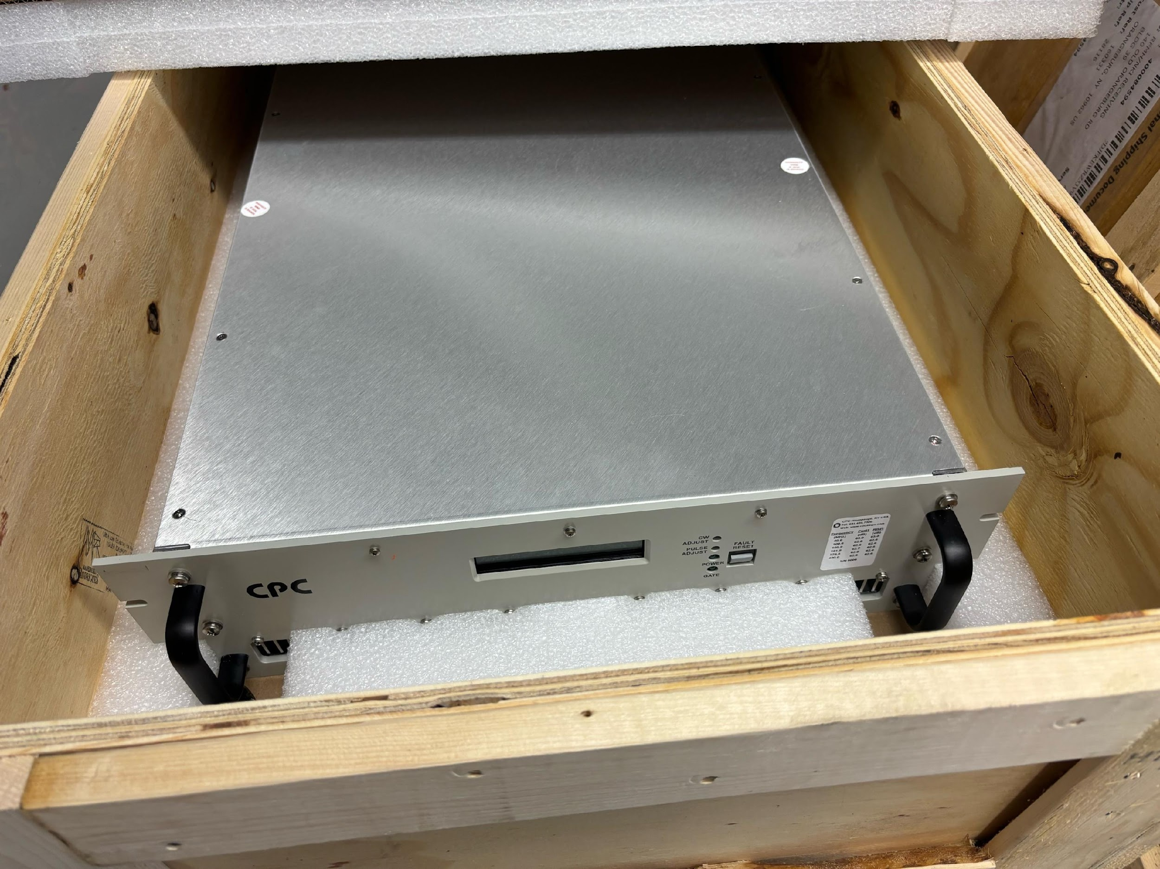
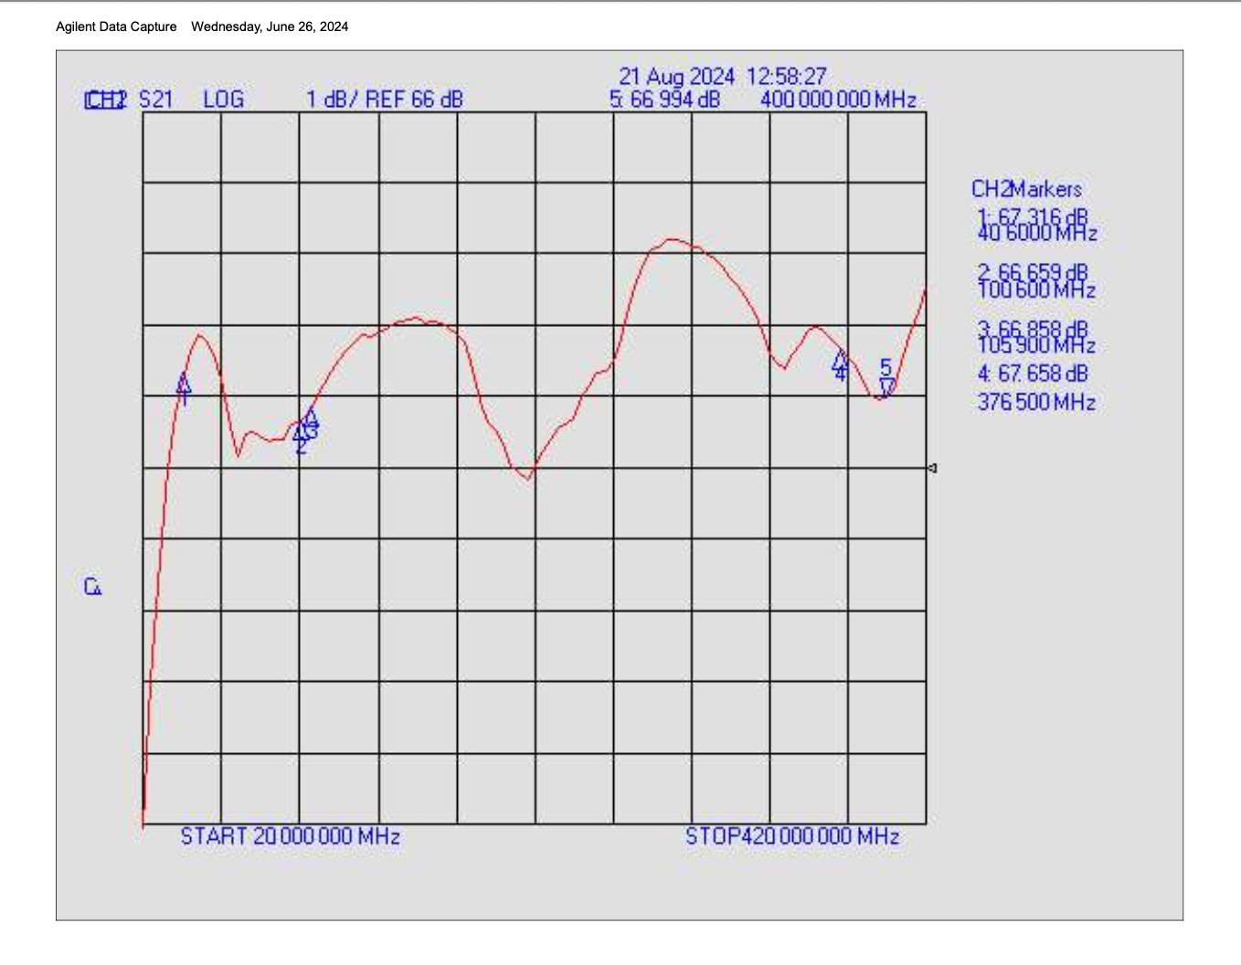
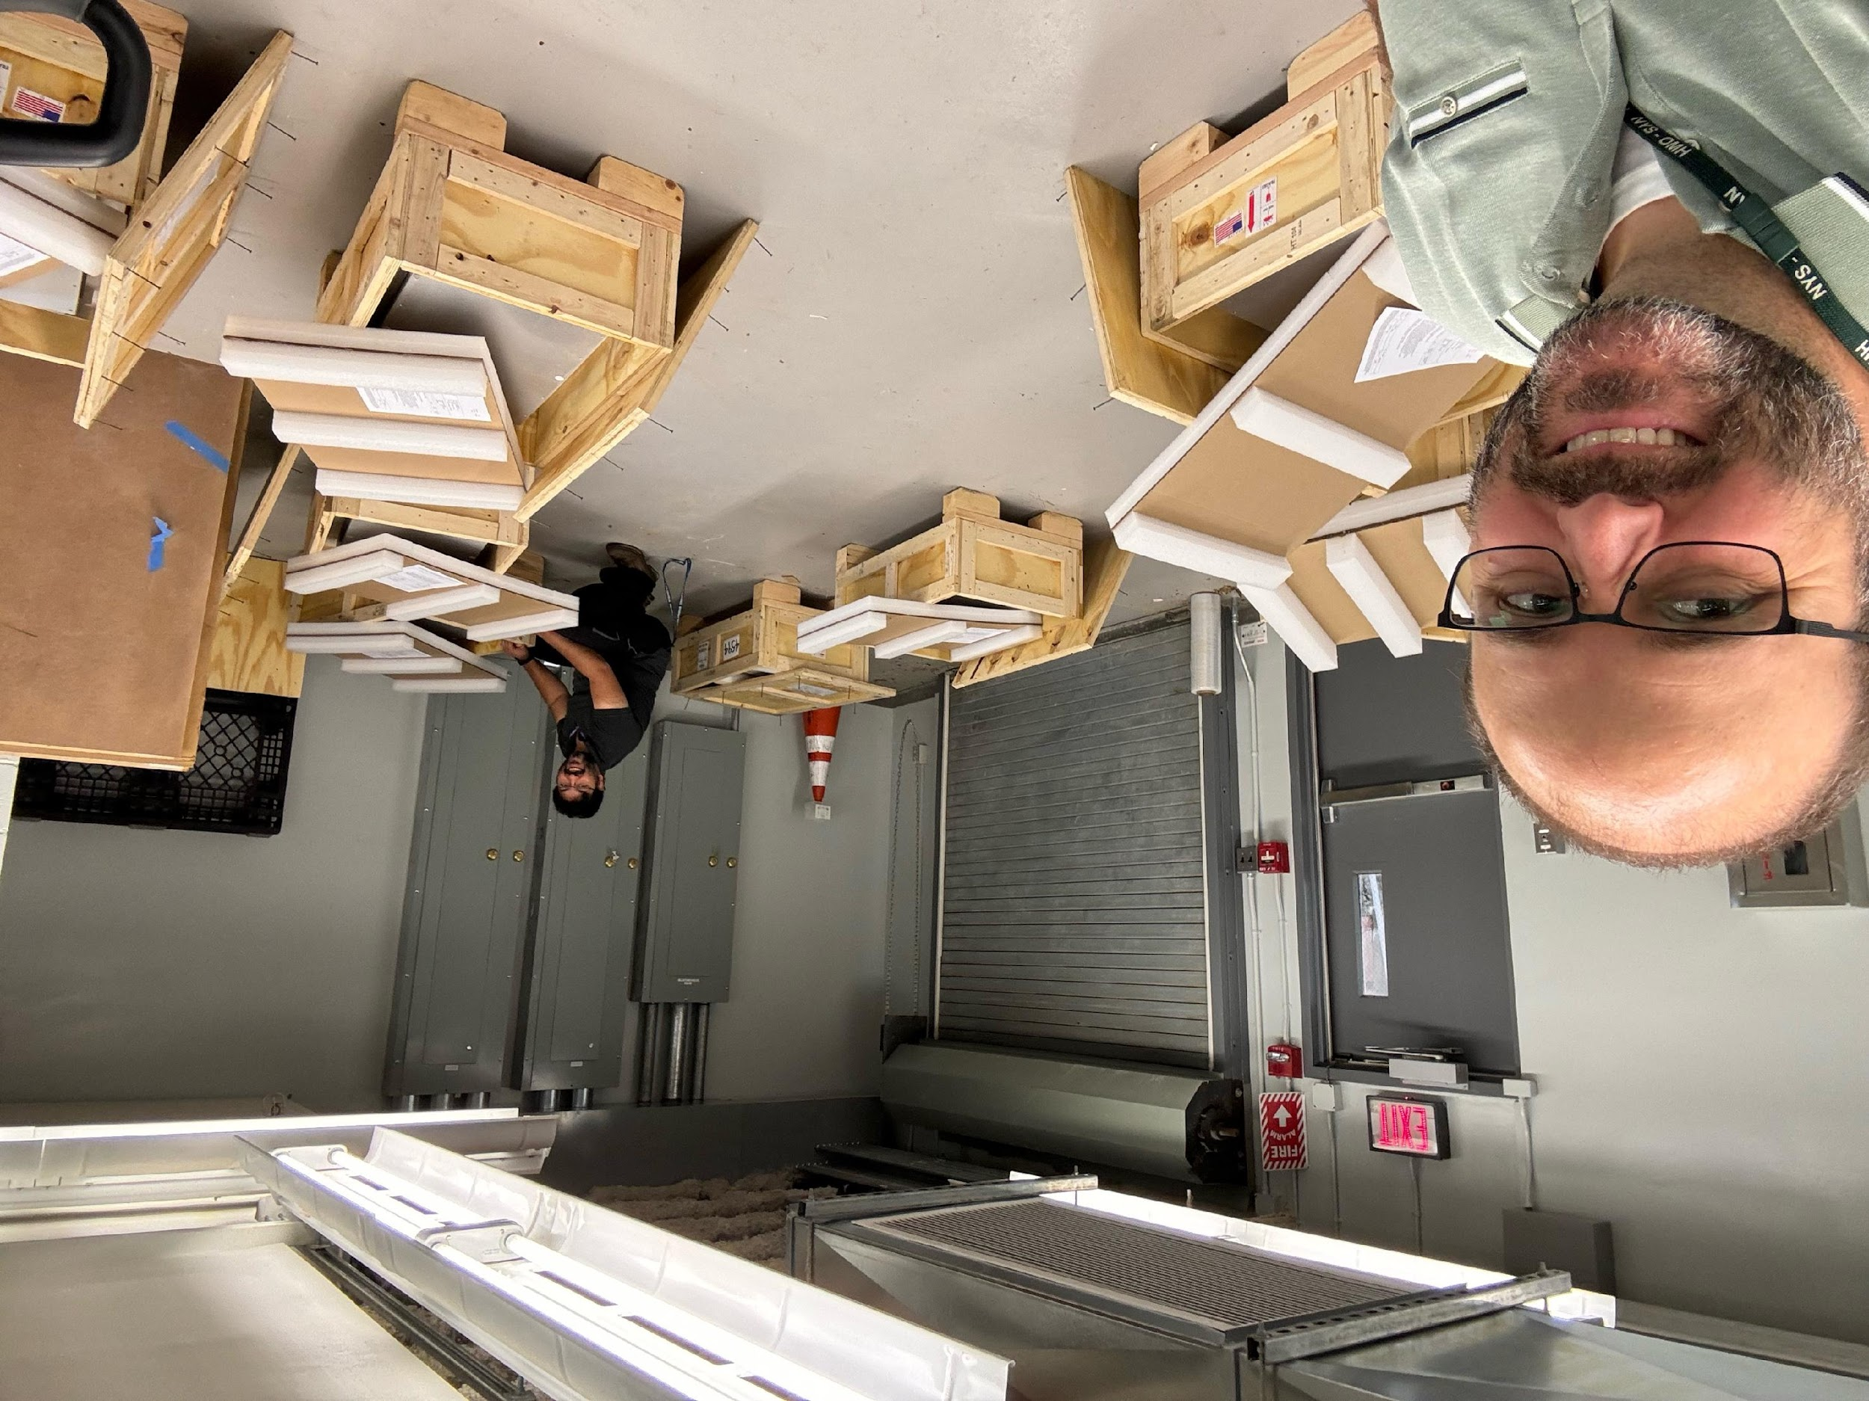
RF Amplifiers – Communications Power Corporation
Multi-channel, multi-frequency, multi-stage power amplifier system
July, 2024
Notes:
400Mhz

Slide 28
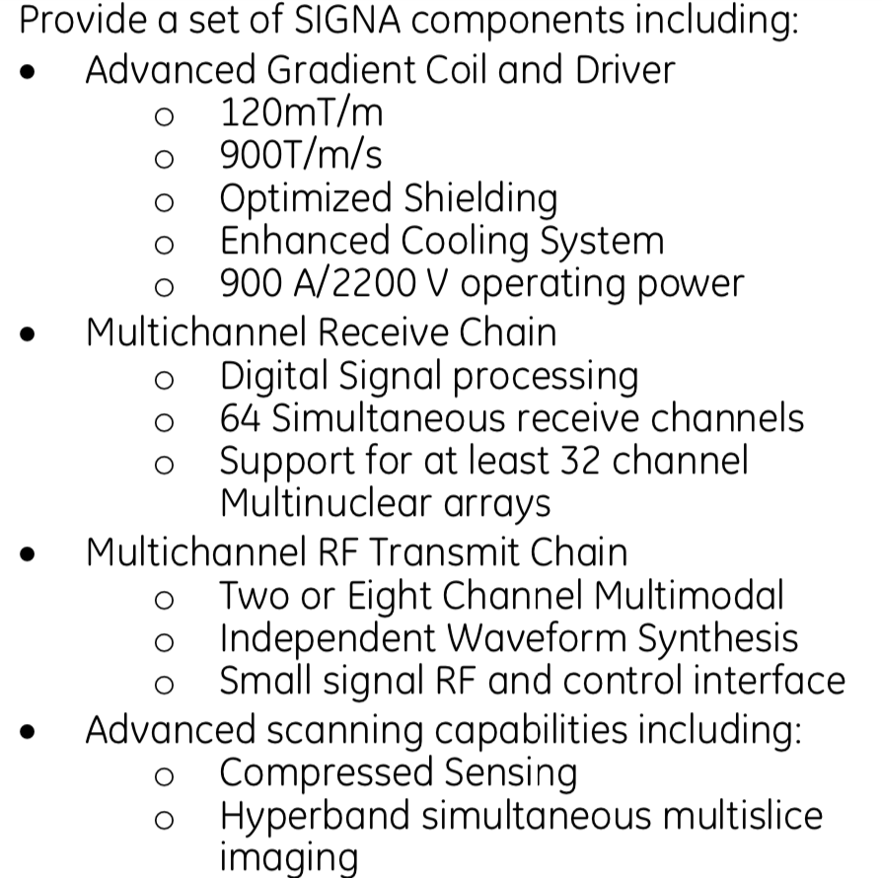
Electronics
GE Healthcare
Components from their SIGNA 7.0T
Notes:
Working on converting the system from a 7T to a 9.4T.

Slide 29
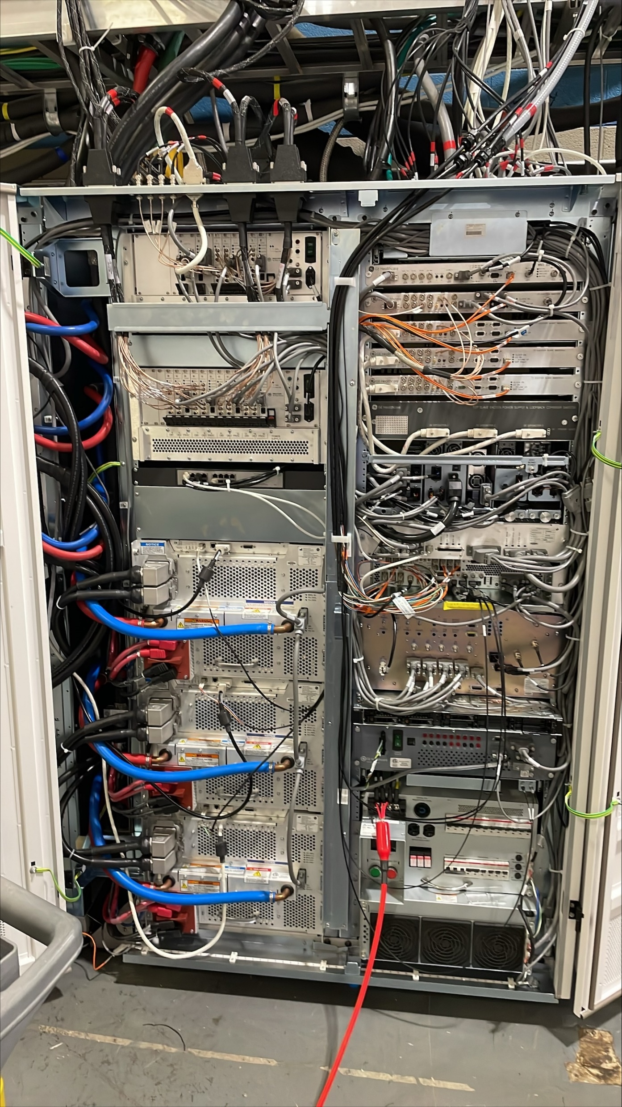
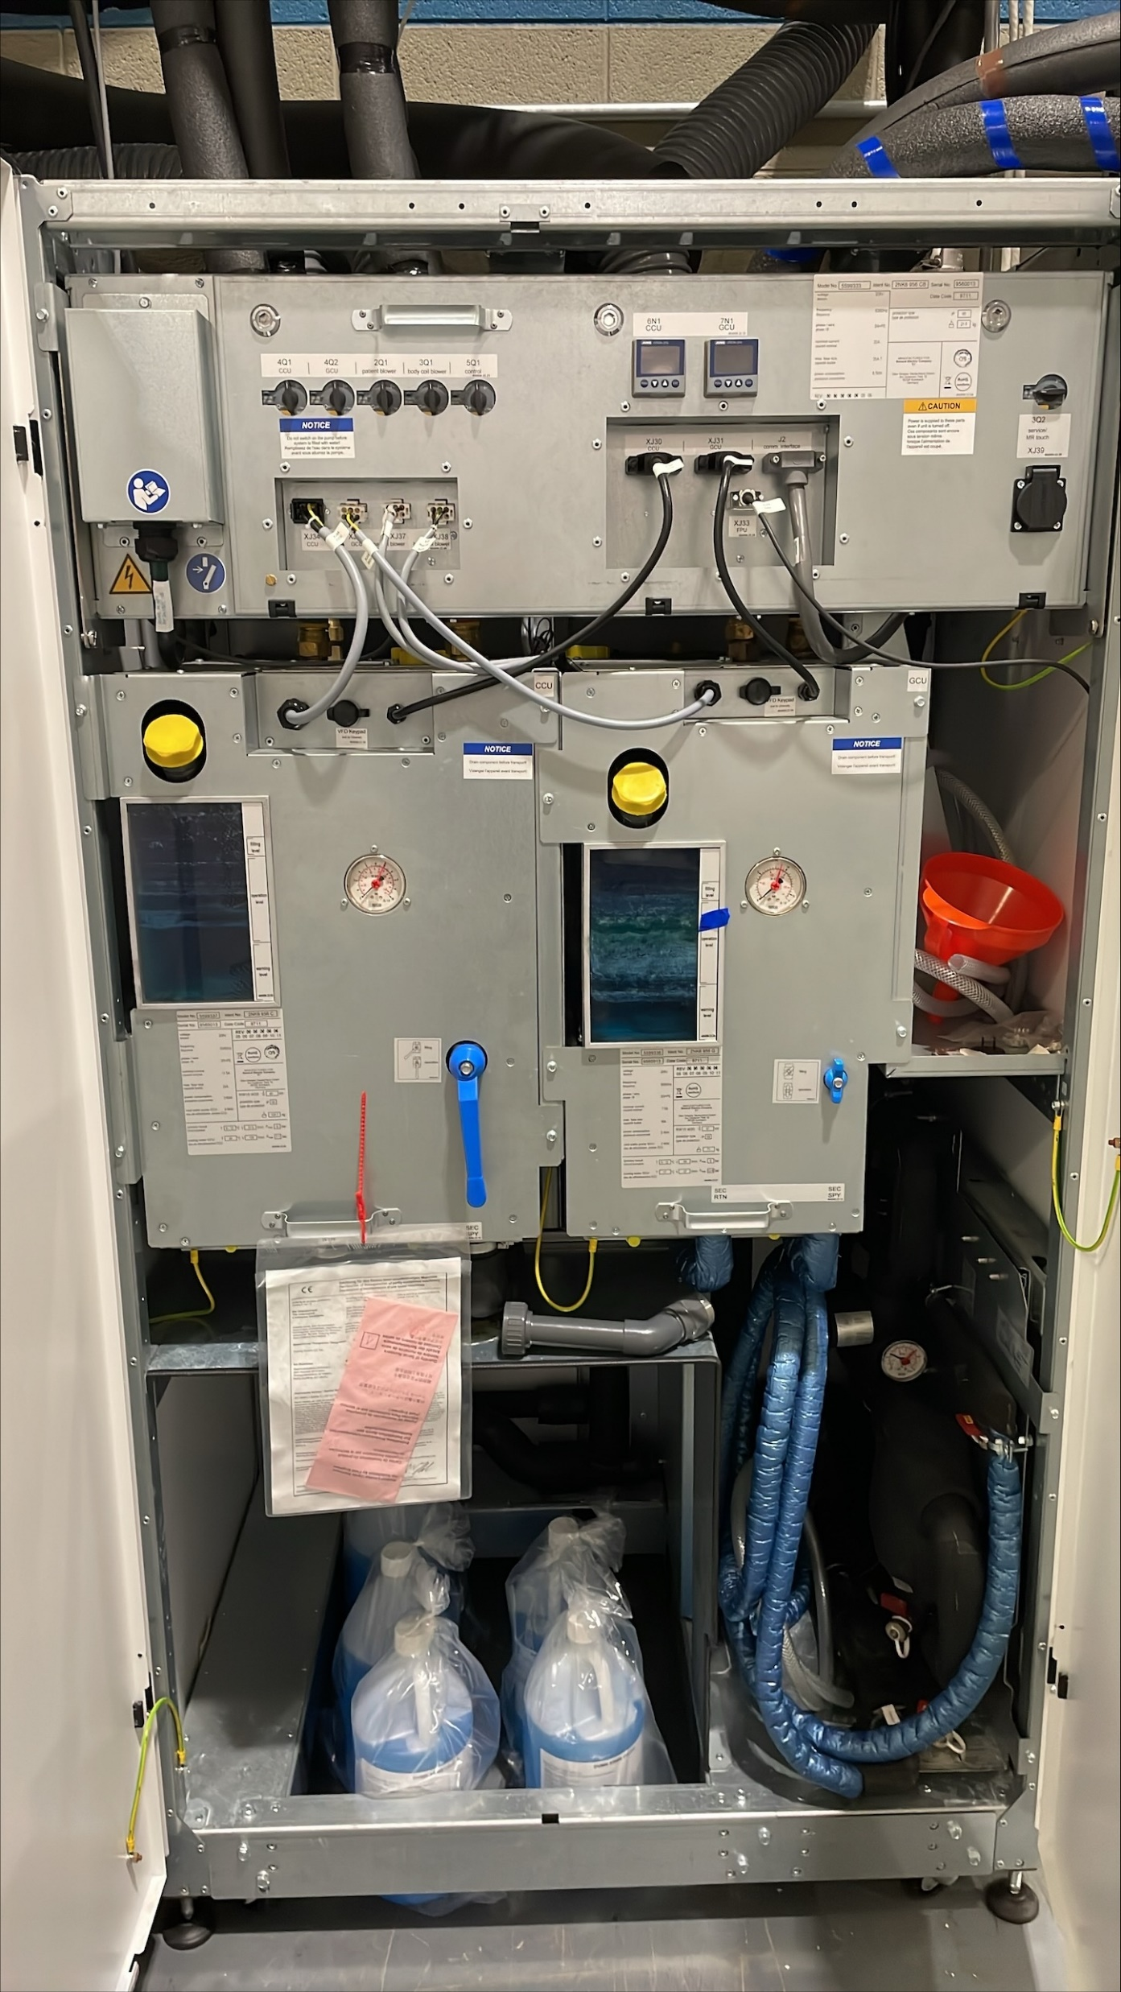
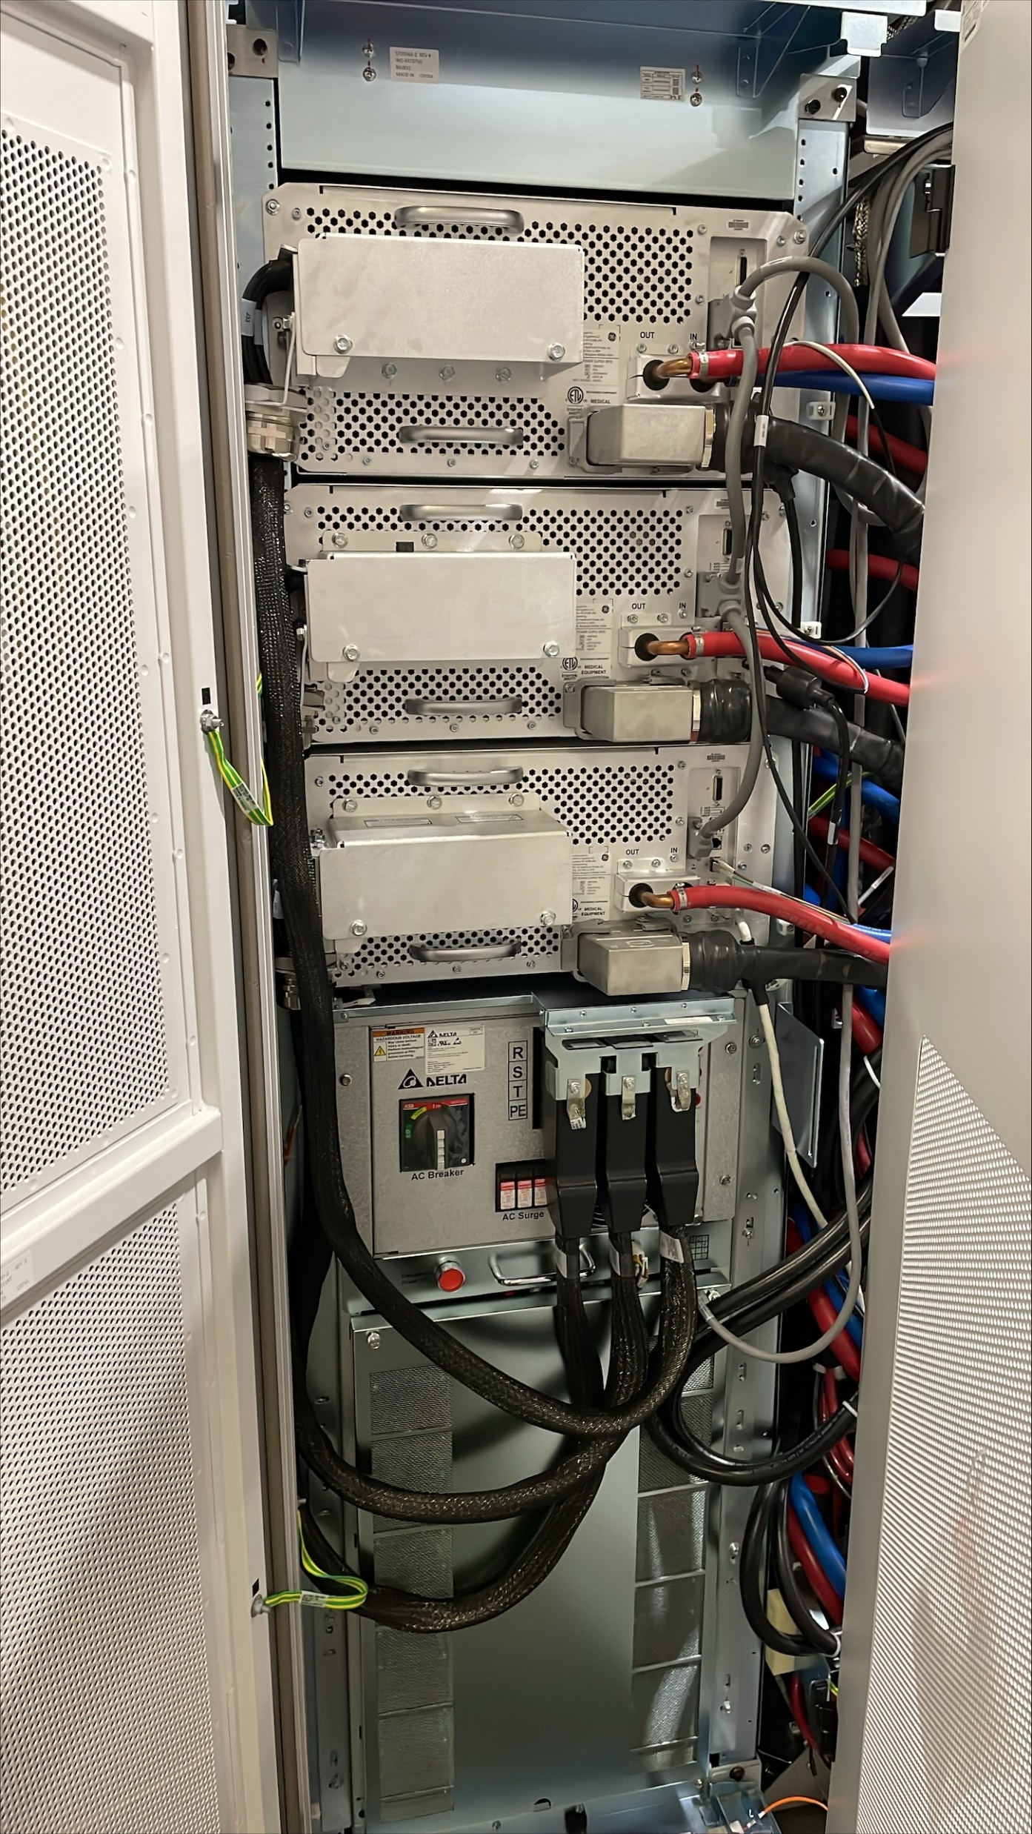
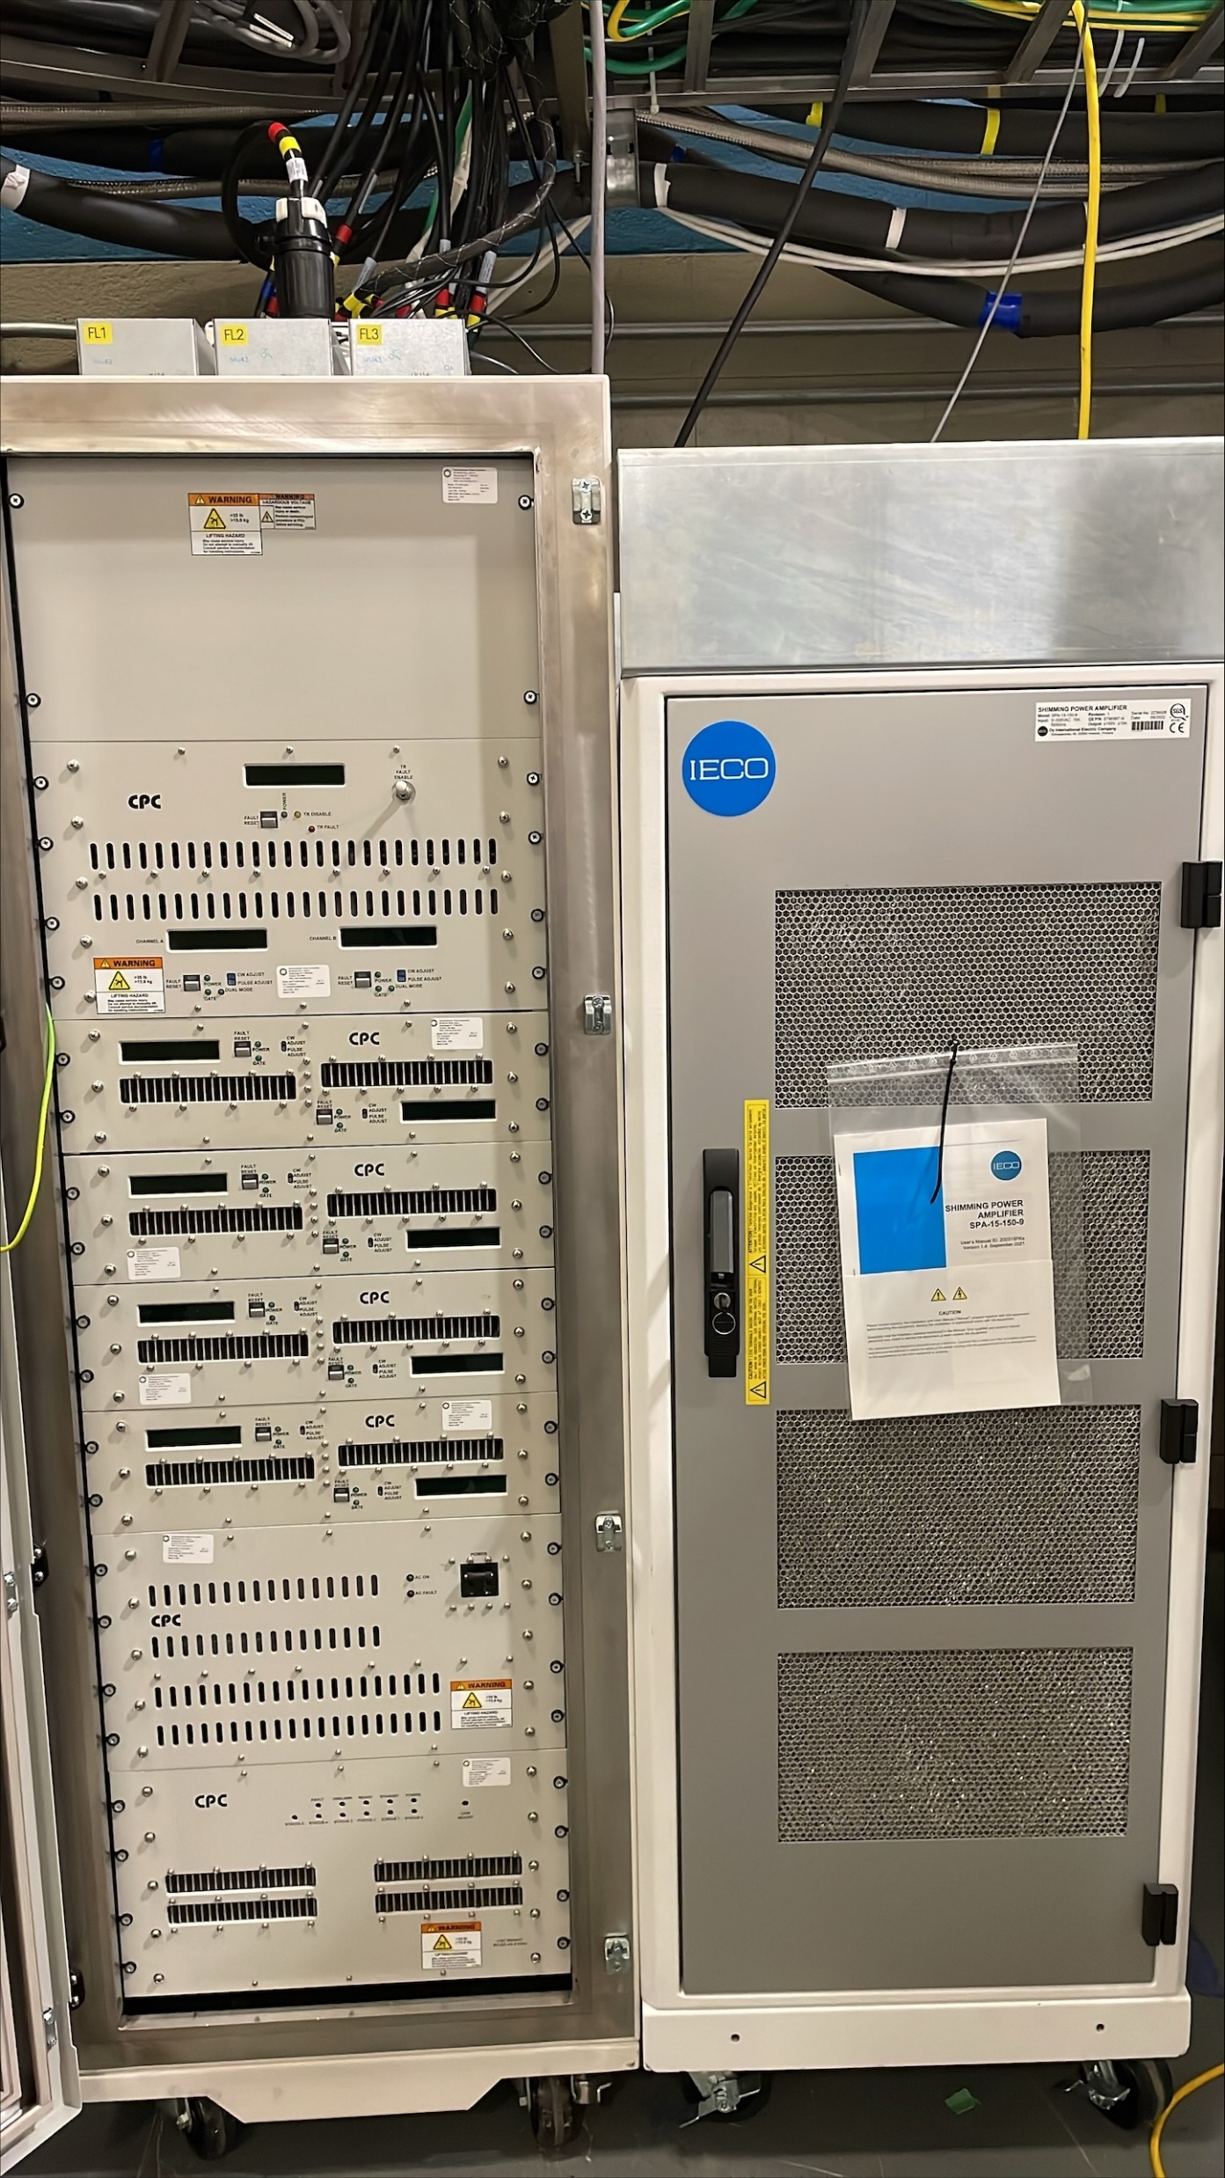

Console
gradient power amplifiers on left and small signal electronics on right
coolant wells, pumps, and controllers
gradient power supplies and system disconnect and power distribution
7T RF amplifier on left and resistive shim controller on right

Slide 30
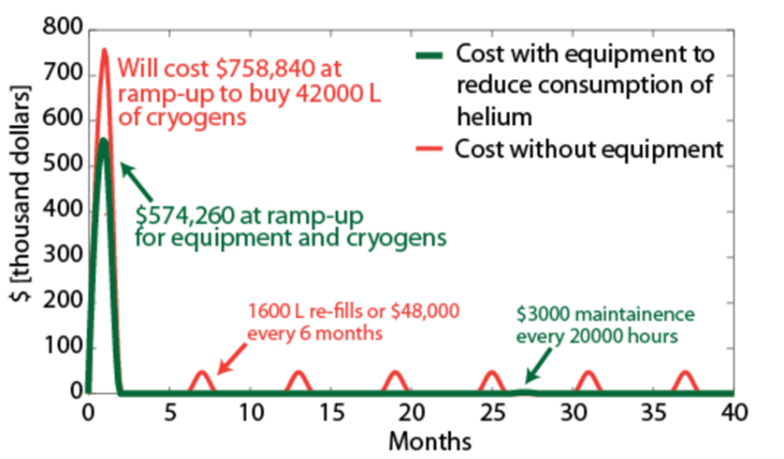
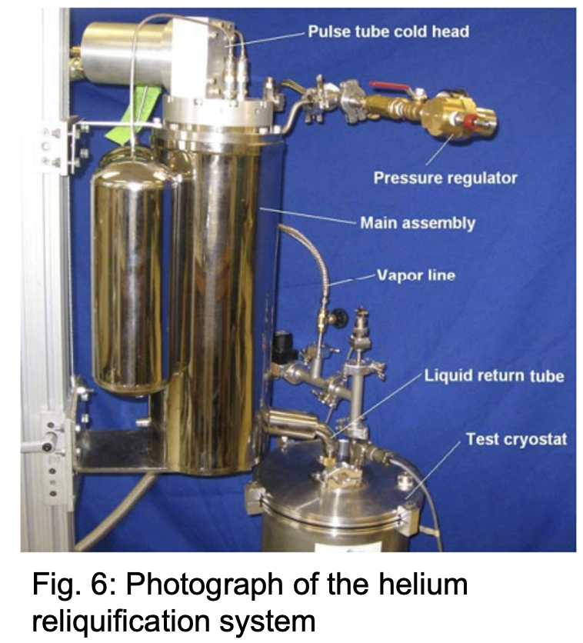
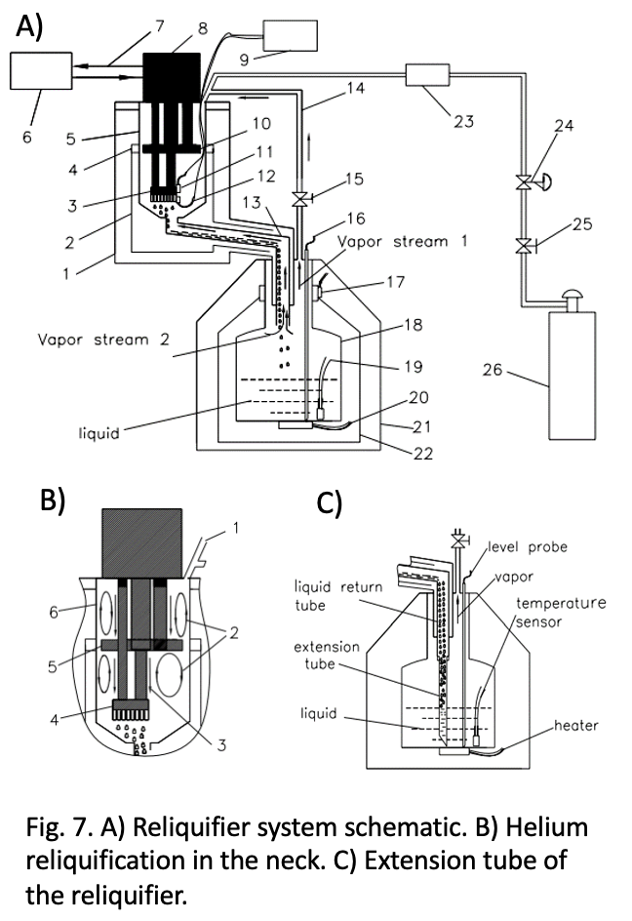
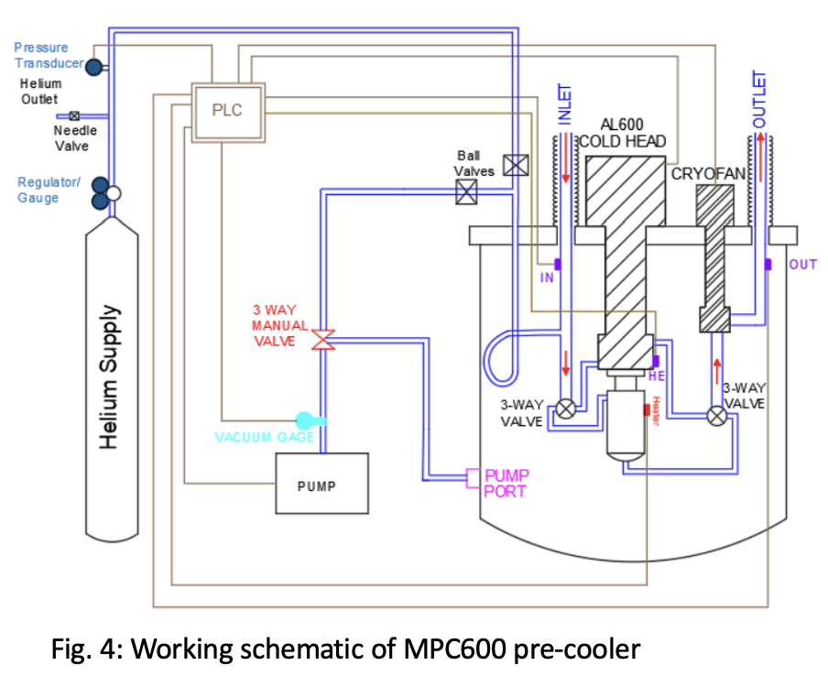
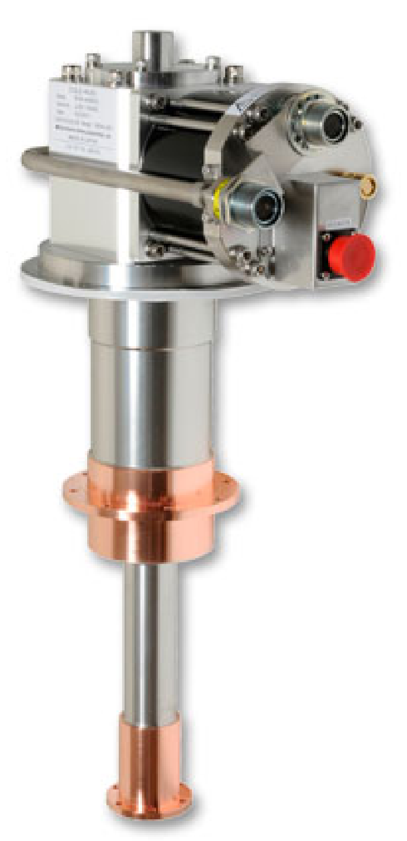
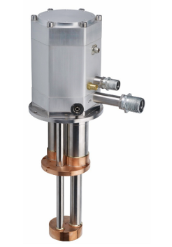
Cryogens
Cryocoolers and cryo-compressors
Pre-cooling system
Reliquefaction system for zero boiloff
Notes:
Pre-cool - Liquid nitrogen – will get us to around 80-77K
Purchase gas Helium, instead of liquid helium.
Logistics to get all that liquid helium will be challenging.
Pre-cooling will take about a month.

Slide 31
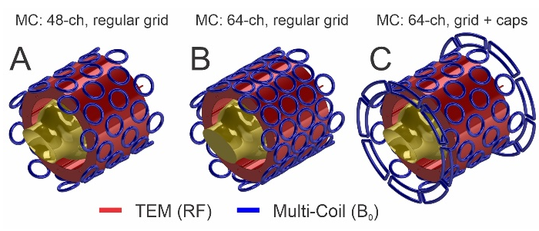
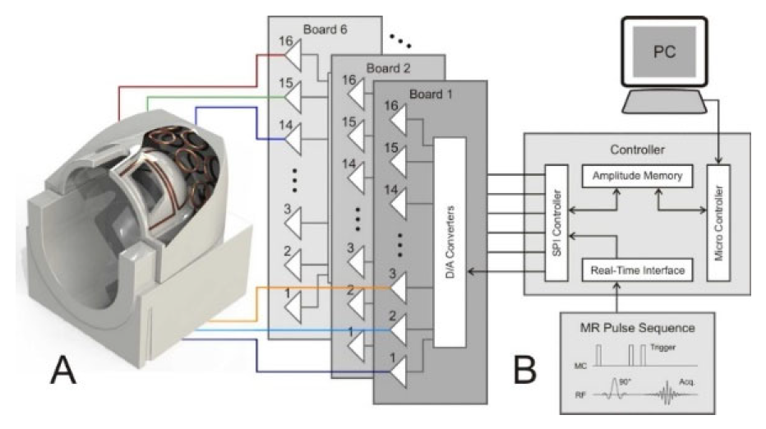

RF coil development

Slide 32


Magnetic Shielding
In Minnesota, the 9.4T required a rectangular 350-ton (700,000 lbs.) DC magnetic shield composed of welded low-carbon steel plate 8” thick at magnet center tapering to 1” thick at the end plates

Slide 33




Fringe field Simulations
Tesla performed simulations for Office of General Services
5 G line c.a. 10 m axially and c.a. 7.5 m radially
9 G line inside the equipment room and control room
Shield weight reduced from 500 tons to 350 tons now

Slide 34




Cold-head magnetic shielding
≤260 G inside the cold-head shield

Slide 35

Site Designing

Slide 36

Site Designing

Slide 37


Slide 38


Slide 39



Slide 40


Site Designing

Slide 41


Site Designing
Current schedule:
100% submission for review and comment: August 2024
Final Submission Check: June 2025
Bidding for Construction: July 2025-October 2025
Award for Contractor: Nov 2025
Start construction: March 2025
Substantial completion: May 2027
Finalize construction: September 2027

Slide 42


Slide 43
Team and Collaborators

Slide 44

Stakeholders - Major
NKI
Vaughan
Franco
Zia
Roe
Milham
Colcombe
Goff
Schroeder
Russ
Columbia
Vaughan
Ray Lee
Sairam Geethanath
Christoph Juchem
NYU Langone
Dan Sodickson
Guillaume Madelin
Ivan Kirov
Ryan Brown
Zhe (Sage) Chen
GE Heathcare
Thomas Foo (Gradients)
Doug Kelly (7T)
Mt. Sinai
Haroutunian
Roussos
Yale
Robin de Graaf
CUNY
Lucas Parra

Slide 45
Thank you,
Questions?

